Slide 1
Navigating 340B and Clinics, Updates and Strategies
Brian Bell and Jill Griffith-Goodwin
WV HFMA Fall Conference
October 3, 2024

Slide 2
Agenda
Provider-Based Overview
340B Program Overview
340B Program Strategy
Manufacturer Barriers
340B Program Outlook

Slide 3
Provider-Based Overview
01

Slide 4
What Is Provider-Based Status?
Relationship between a main provider & another facility whereby the other entity is considered a department of the main provider. Determination of provider-based status is governed by the regulation at 42 CFR 413.65 & further explained in Program Memorandum Transmittal A-03-030.
The Medicare/Medicaid provider-based status regulatory requirements apply to a facility if the status of the facility as provider-based or freestanding affects:
Medicare or Medicaid payment amounts
The scope of benefits available to a Medicare beneficiary in or at the facility
The deductible or coinsurance liability of a Medicare beneficiary in or at the facility
Types of provider-based facilities/organizations:
Department of provider (hospital outpatient departments)
Provider-based entities
Clinic
RHC
Remote location of a hospital
Furnishes IP services under a hospital’s certification and CMS #

Slide 5
On-Campus & Off-Campus
Measure “as the crow flies”
On-campus locations are:
Buildings or structures within 250 yards from main building
CMS Regional Office has discretion to determine on-campus on case-by-case basis
Joint ventures must be located on main campus of a provider who is partial owner
Off-campus locations are:
Not on the main campus or 250 yards from main building or a “remote location” of the hospital
Must be located within a 35-mile radius from main building
Alternative test, if unable to meet 35-mile rule within the same state as hospital:
DSH Adjustment Factor >11.75% & has agreement with local government to provide indigent care, or
75% of clinic patients served reside in same ZIP code as at least 75% of hospital patients served

Slide 6
Medicare Provider-Based Reimbursement
Off-Campus Locations
Subject to site-neutral payment rules
More than 250 yards, less than 35 miles from main hospital
35-mile rule does not apply to RHCs
Excepted Locations – HOPDs Established Prior to November 1, 2015
Paid 100% of OPPS for procedures
Paid 40% of OPPS for evaluation & management (E&M) codes (equivalent to physician fee schedule)
Specific to location – service changes acceptable, with limitations
OPPS Final Rule – Rural SCH Excepted Locations will be paid at 100% OPPS for E&M codes
Non-Excepted Locations
Regulatory intent – Paid Physician fee schedule for procedures & E&M codes
Operationalized as: Reduced payment to 40% of APC payment (MPFS Relative Adjuster)
New offsite locations (after November 1, 2015)

Slide 7
Space Sharing Requirements
All certified hospital space, locations must be 100% hospital usage
Can’t carve out areas as non-hospital or part-time
USPS designation (address)
QSO-19-13 finalized November 2021
Co-location occurs when two Medicare certified hospitals or a Medicare certified hospital and another healthcare entity are located on the same campus or in the same building and share space, staff, or services.
Each entity is responsible for demonstrating separate and independent compliance with the hospital’s CoPs.
Consider whether hospital space used by another healthcare entity pose a risk to the hospital’s CoPs.
Areas of consideration when sharing space may relate to patient rights, infection prevention and control, governing body, and/or physical environment.

Slide 8
Medicare Enrollment 855 Requirements
855A new enrollment in PECOS
Accuracy
Correct locations
Provider information
Locations must comply at requested effective date

Slide 9
Compliance Requirements
Assessment of provider-based compliance for all locations
Promote compliance
Identify risks & opportunities
Assess on-campus & off-campus
Develop assessment checklist & depository for supporting documentation & attestations

Slide 10
Provider-Based Billing Clinics
Path to the 340B Program
Financial
Accreditation
Integration
Public Awareness
340B Impact
Reimbursement impact from affected payors
Co-insurance impact on patients
Any applicable costs associated with getting clinics to standard
Clinics must be up to hospital standards
Specifics depend on accrediting body
Potential site-visits
Appropriate licensure
Clinical integration
Clinical staff
Reporting structures
EHR integration
Financial integration
Included on most recently filed Medicare Cost Report
OPAIS registration
Policies & procedures
Clinics must have naming associated with hospital
Will need to update all collateral & signage
Patient and staff education

Slide 11
Outline
Provider-Based & 340B Timeline
The following timeline outlines converting non-eligible departments and completing child site registration for the 340B Drug Pricing Program. Process may take 18-24 months.
Months 1 & 2
Months 3-6
Year End
File MCR
Next Quarter
Following Quarter
Assess financial impacts on reimbursement.
Identify any gaps and develop an action plan.
Begin the provider-based conversion.
Clinics must show Medicare charges on an eligible cost-center.
File the Medicare Cost Report (MCR).
Register the clinics as child sites with HRSA.
The earliest point at which the clinics qualify for the 340B Drug Pricing Program.
Who Needs to be Involved?
Key Departments for Success: Leadership, Revenue Cycle, Finance, HR, Marketing, Compliance, Legal, Facilities, Patient Care

Slide 12
Legislative Concerns – Site Neutrality
NPI for each off-campus location
Attestation biannually for off-campus locations
Site neutral payments for drug admin
Bills not enacted
Consolidated Approp Act 2024 – no Site Neutral provisions
The Patient Act of 2023
Site Act of 2023
MPact Act of 2023
Primary Care and Health Workforce Expansion Act of 2023

Slide 13
340B Program Overview
02

Slide 14
340B Drug Pricing Program Overview
Part of the Public Health Services Act, section 340B & Medicaid rebate program
Federally mandated drug pricing program created in 1992
Expanded under the Clinton, W. Bush and Obama administrations
Requires drug manufacturers to provide front-end discounts on covered outpatient drugs to help stretch scarce federal resources at covered entities that serve vulnerable and indigent populations

Slide 15
Eligibility
PED
DSH
CAN
CAH
RRC
SCH
X
X
X
Subject to GPO Prohibition
X
X
X
X
Subject to Orphan Drug Exclusion
Disproportionate Share Adjustment %
>11.75
>11.75
>11.75
≥8.0
≥8.0
Designated by CMS
X
X
X
X

Slide 16
HRSA Audits
YTD FY23 Statistics
Results are made publicly available
Conducted by the Bizzell Group
Results posted for 152 audits (as of July 24, 2024)​
65 audits resulting in Corrective Action Plans​
35 audits resulting in manufacturer repayment​
Audits occurred in 39 states
Initially had an educational tone, but have since turned punitive with the introduction of penalties for non-compliance
Focus on contract pharmacy arrangements, diversion, duplicate discounts, & database records
Source: HRSA, Program Integrity: FY23 Audit Results

Slide 17
340B Program Strategy
03

Slide 18
340B Steering Committee
Program Oversight & Compliance
A hallmark of successful organizations is a strong oversight committee that takes a compliance first approach to managing the 340B Program across the organization.
Roles & Responsibilities
Diverse Stakeholders
Compliance
Maintain compliance foundation
Implement internal controls
Continuous internal monitoring
Documented use of savings
IT
Legal
Pharmacy
Patient Services
Compliance
Finance
Policies and procedures
Conduct frequent mock audit procedures
Utilize independent external reviews
Medicaid BIN/PCN/GRPs
Eligible locations
Qualification parameters

Slide 19
340B KPIs
Tracking Dollars
340B Revenue (Savings) and Reimbursement
340B Purchases
Provider Productivity & the Value of Prescriptions
Measurability is key to demonstrating growth
Tracking Rates
Capture Rate
Participation Rate
340B & non-340B Spend
Quality Metrics
Maintenance Medication Adherence
Percentage of Refills Filled
Social Determinants of Health

Slide 20
Key Performance Indicator
Capture Rate
Capture rate may be the most important performance indicator for your program and in-house pharmacies. Closely monitoring this metric is important to support patient care and access to medications.
Organizations should strive for a capture rate over
60%

Slide 21
Key Performance Indicator
340B Savings
It is important for covered entities understand the impact the 340B Program has on communities and be able to communicate that impact.
Call to Advocacy
Contact Congress and State Legislators
Work with advocacy groups
Report overcharges to HRSA
Educate your board
Maximize and maintain your 340B savings
Assess purchases across all 340B Program settings
Assess compliance costs including internal resources, vendors, and consultants
Assess the usage of 340B savings for the organization
Develop process to track and report the use of 340B savings

Slide 22
Contract Pharmacy
Addressing Manufacturer Policies
ESP
Direct Replenishment
Entity Owned Pharmacy
Options available to covered entities to minimize impact of contract pharmacy restrictions

Slide 23
Community Pharmacy
The Power of an In-House Pharmacy
In today’s evolving healthcare landscape, the advantages of in-house pharmacies are becoming more important than ever.
Specialty
Financial Assistance
340B Program
Transitions of Care
Employer Prescription Plan
Mail Order
Why consider a pharmacy for your organization?
High-quality patient care
Access to medications
Escalating administrative and dispensing fees
Restrictive manufacturer policies for contract pharmacies
Additional revenue stream

Slide 24
Outpatient Pharmacy
Expanding Ambulatory Pharmacist Roles
Integrating a clinical pharmacist into the care team with 340B knowledge is an often-overlooked component for covered entities looking to improve outcomes and place patients at the front of every decision.
Components
Considerations
Risk Areas
Services: pharmacotherapy, chronic care management (CCM), medication therapy management (MTM)
Collaborative practice agreements
Referral arrangements
Documentation
Comprehensive tracking mechanism
Pharmacist as a qualifying provider
Pharmacist embedded in a qualifying location
Medicare charges
Payor requirements / telehealth
Meeting the patient definition
Consistent billing practices for services across all payor types
Patient definition
Inadequate documentation
Poor tracking / coordination of components
Policies and procedures
Differences in billing practices by payor
Communication gaps between providers, patients, and pharmacists

Slide 25
340B Operations
Vendor Management
Split Billing Software
Data feed review
Accumulator & utilization review
Routine monitoring practices
Third Party Administrators (TPAs)
Review data feeds
Review settings: qualification, locations, providers, exclusions, etc.
Contract alignment & performance

Slide 26
Manufacturer Barriers
04

Slide 27
Contract Pharmacy
Addressing Manufacturer Restrictions
Since September 2020, manufacturers have taken steps to unlawfully block and limit access to 340B savings. Hospitals lost $1.1B in the 340B savings from only five manufacturers in 2021.
75%
33%
of hospitals making cuts
of hospitals at risk of closure
39%
23%
average reduction in contract pharmacy benefit (CAH)
average reduction in contract pharmacy benefit (DSH/RRC/SCH)
Source: 340B Health

Slide 28
Contract Pharmacy
Addressing Manufacturer Restrictions
Goal: Improve 340B transparency
Owned by Second Sight Solutions
Purported to help the prevention of duplicate discounts
Claims data is requested for all payors
Works best if protections exist against discriminatory reimbursement practices
The manufacturer’s view of duplicate discounts is different than that of a CE…

Slide 29
Legal Action
District Courts
Court of Appeals
Supreme Court
3 lawsuits across the districts
2 sided with manufacturers, 1 with covered entities
All have been appealed
Novartis/United Therapeutics v. HHS in District of Columbia
Eli Lilly v. HHS in 7th Circuit
Sanofi/Novo Nordisk/AstraZeneca v. HHS in 3rd Circuit
May end up in Supreme Court if Appeals issue diverging opinions
2 courts sided with manufacturers
1 case pending

Slide 30
Johnson & Johnson
Rebate Model
JNJ sent letters to covered entities on August 28, 2024
HRSA strongly opposes
HHS sent letter to JNJ on September 17, 2024
Civil Monetary Penalties
Termination from Federal Health Insurance Programs
JNJ responds and states, “…they will constructively engage with HRSA on the 340B program to identify solutions that will help modernize the program for more sustainable future…”
Lawsuits
Kalderos case
Other manufacturers?

Slide 31
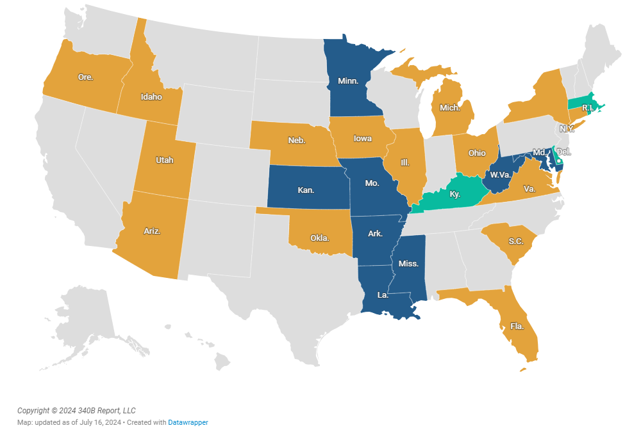
Legislative Update
Addressing Manufacturer Restrictions
Image Source: 340B Report

Slide 32
340B Program Outlook
05

Slide 33
OPPS Remedy Timeline
CMS releases Final Rule, reducing Medicare payment for most 340B drugs
US Supreme Court rules that cuts were illegal in 2018 & 2019
CMS resumes paying hospitals at ASP + 6% (equal to rate prior to the cuts)
December 2018
September 2022
November 2023
January 2018
June 2022
September 2023
Hospital groups sue CMS over the payment cuts
Federal District Judge rules that cuts were illegal in 2020–2022
CMS finalizes rule for a lump sum payment, cutting future payments as an offset
However, the final rule did not address Medicare Advantage plans.

Slide 34
Unregistered Child Sites
Hospitals with sites already on their MCR but not on OPAIS, must register the sites on OPAIS during the next registration window (January 1–16)
(Oct. 2023) HRSA announces they will be prohibiting the use of 340B drugs at unregistered child sites. Organizations have two paths to compliance:
Hospitals with sites not on the MCR nor OPAIS, must submit the following information to HRSA by January 25, 2024:
Name of child site
Date the site will be listed on the MCR, which must be the next one filed
Date the hospital will register the site on OPAIS
A lawsuit of more than 40 hospitals and health systems is currently being pursued against HRSA as it relates to this ruling.

Slide 35
Inflation Reduction Act
Overview
Key Components
Important Dates
Drug Price Negotiation Program
Drug Selections – only Part D drugs for 2026 & 2027
Maximum Fair Price (MFP)
Litigation
Medicare Part B and Part D Inflation Rebates
Manufacturers are required to pay a rebate on a unit of a drug paid under Part B or D where price of the drug increases faster than inflation.
Medicare Part D Redesign
Out of pocket threshold, coverage gap, insulin, vaccines
Medicare Part B Reimbursement Changes
Payment rate for biosimilars & add-on payments
January 1, 2024
Removal of 100% AMP rebate cap
January 1, 2026
Drug negations take effect – 10 Part D drugs
January 1, 2028
Part B drugs to be included in negotiations

Slide 36
Inflation Reduction Act
340B Program
Covered entities need to prepare for the proposed changes and implications of the IRA. It is important to be actively assessing the impact to program performance in anticipation of changes.
Removal of 100% AMP rebate cap
Slow rate of price increases
Lower prices
Medicaid best price
340B ceiling price
Penny pricing
MFP implications
Difference between MFP and 340B price
MFP below 340B price
Contract pharmacies
CMS Guidance December 2023
CMS 2025 physician fee schedule proposed rule
Assess operational changes & financial impacts to program

Slide 37
Legislative Update
Administrative Dispute Resolution (ADR)
42 USC § 256b(d)(3) Administrative Dispute Resolution Process
Rule created under the Affordable Care Act
Proposed rule not provided until 2016
HHS issued final rule in 2020, though claims filed against rule leading to the new final rule being issued April 2024
Final rule went into effect June 18, 2024
Chevron implications

Slide 38
Legislative Update
Proposed Legislation
Preserving Telehealth, Hospital, and Ambulance Access Act​
To amend title III of the Public Health Service Act to include rural emergency hospitals in the definition of a covered entity for purposes of the 340B drug discount program.​
The 340B PATIENTS Act of 2024​
Medicare PBM Accountability Act​
Lower Costs, More Transparency Act​
Real Education and Access for Healthy Youth Act of 2023.​
PATIENT Act of 2023​
To amend title III of the Public Health Service Act to ensure transparency and oversight of the 340B drug discount program​
MVP Act​
340B Reporting and Accountability Act​
PROTECT 340B Act of 2023​
340B Accountability Act of 2023​
Drug Pricing Transparency and Accountability Act
340B ACCESS Act
Sponsored by Rep. Bucshon (R-Ind.)
Limitations on participation and purchasing
Patient definition
Additional eligibility and reporting requirements
340B PATIENTS Act
Sponsored by Rep. Matsui (D-Calif.)
5 additional democratic co-sponsors
Contract pharmacy
SUSTAIN 340B Act
Bipartisan

Slide 39
Legislative Update
SUSTAIN 340B Act
Key Components
John Thune (R-SD)​
Tammy Baldwin (D-WI)​
Jerry Moran (R-KS)​
Shelley M. Capito (R-WV)​
Ben Cardin (D-MD)​
Debbie Stabenow (D-MI)
6 Bipartisan Senators (3 Republicans, 3 Democrats)
Draft legislation after 6 months of meetings
RFI – Due April 24, 2024
Contract Pharmacy
Transparency
Program Integrity
Duplicate Discounts
PBM/Insurer Provisions
Additional Provisions

Slide 40
Legislative Updates
Senator Cassidy Investigation
Contract Pharmacies
Hospitals
Community Health Centers
CVS Health
Walgreens
Bon Secours Mercy Health
Cleveland Clinic
Sun River Health
Yakima Valley Farm Workers Clinic

Slide 41
Visits With Congress
15 Congressional offices
Advocacy organizations
“Good” & “bad” players
Will need compromise between all 340B parties
Watching for future rule changes

Slide 42
Advocacy Action Steps
Contact Congress & state legislators
Work with advocacy groups
Report overcharges to HRSA
Educate your board
Maximize & maintain your 340B savings

Slide 43
Brian Bell
Principal
P: 513.562.5562
brian.bell@us.forvismazars.com
Jill Griffith-Goodwin
Managing Director
P: 304.414.2613
jill.griffithgoodwin@us.forvismazars.com

