Slide 1
C-Suite Guide to Margin Transformation West Virginia HFMA
October 2024
RSM | 1

Slide 2
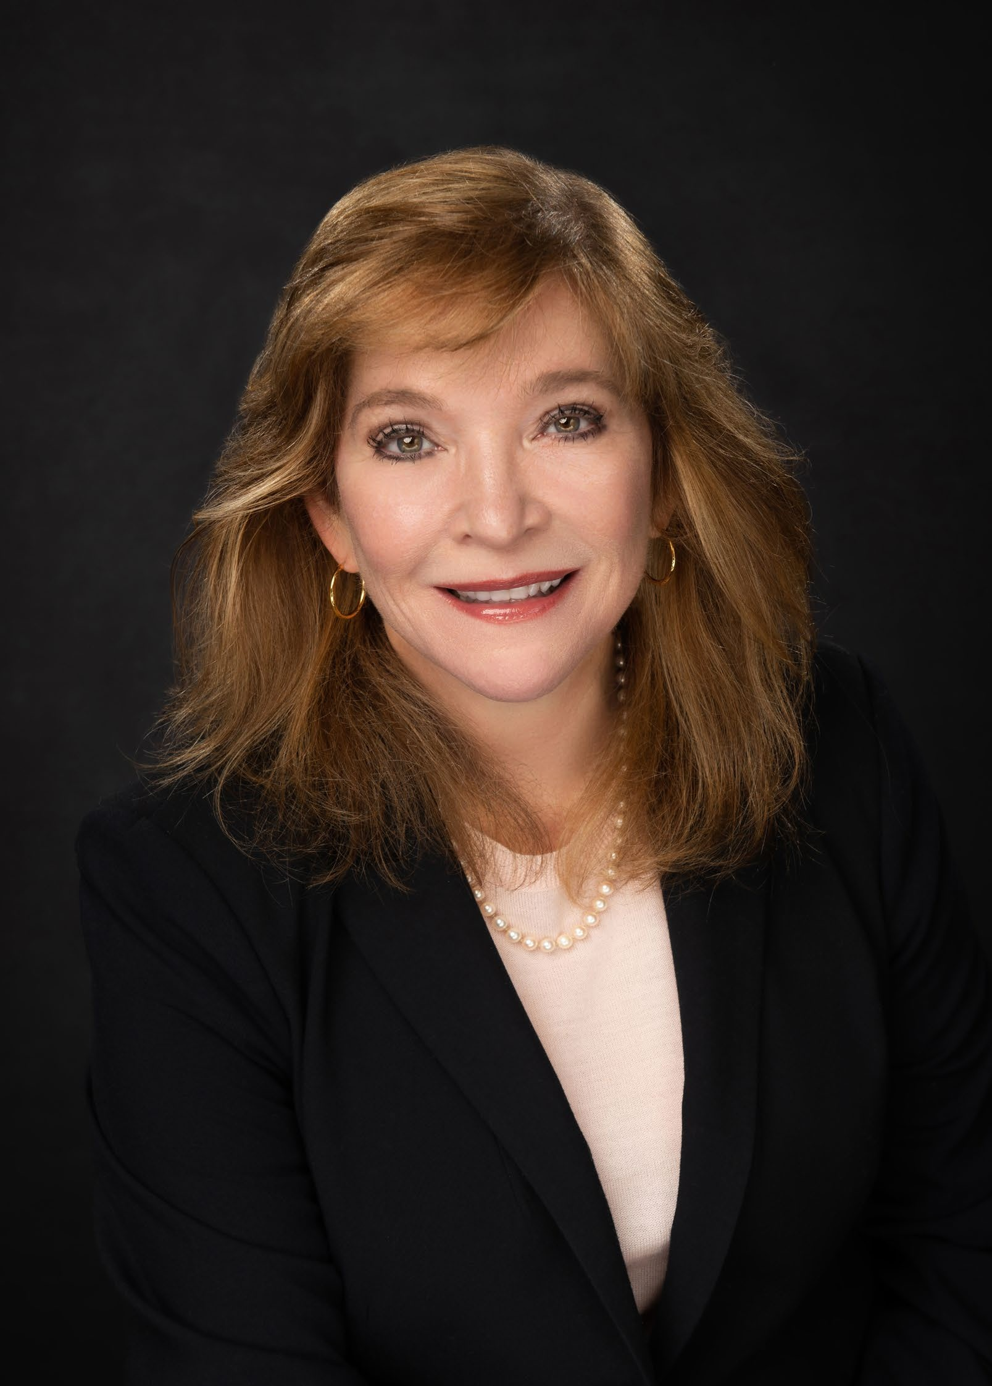
Presenter
Beryl Ramsey Finlan, MBA, FACHE
Served as CEO, COO, CFO, Division President
Over 35 years industry experience
Led in both academic and community settings in for-profit and non – profit healthcare systems
Millions of $ in ROI generated for health care clients
National Leader Houston, Texas
CEO Advisory & Clinical Operations
RSM US, LLP
beryl.ramsey@rsmus.com
+1 713 501 6250
Beryl provides unique health care executive level consulting for health systems and hospitals which results in organization wide engagement that helps the client drive performance improvement and margin transformation with the use of data analytics and change management. Beryl has experience in working with large for-profit systems as well as independent Critical Access Hospitals, smaller hospitals and academic non-profit medical centers.

Slide 3
Learning Objectives
By the end of this course, you will be able to:
Understand the key C-suite considerations and steps involved in initiating a margin transformation project:
Identify best practices for the C-Suite team when approaching a Margin Transformation project
Determine the scope of what the C-suite team can accomplish independently and identify areas where external assistance may be beneficial
Gain insights into the timeline and expectations for achieving results from margin transformation efforts, including factors impacting timeline and milestones to assessing progress
Describe how to achieve margin improvement through data-guided process transformation
Explain how to utilize data to identify and achieve ROI opportunities
Identify examples that achieve margin transformation and improvement
4

Slide 4
State of the union – the post-pandemic world
New workforce challenges
Labor shortage
Mental health
Training deficit for RN’s that graduated during the pandemic
Payor challenges
Increased denials
Downgrading DRG’s
Observation versus inpatient
Automation in health care
Leveraging new technology
Chronic disease management increases Supply cost increases
Increased volumes
Disease specific programs unraveling Unreliable reporting analytics
During the pandemic nearly 20% of healthcare workers quit their jobs (HFMA)
Up to 40% of health care workers plan to quit their job by 2025
(HFMA)
Outlook for RN’s in 2030 is a projected shortfall of 275,000 nurses from 2020-2030 (Haddad)
Haddad LM, Annamaraju P, Toney-Butler TJ. Nursing Shortage. [Updated 2023 Feb 13]. In: StatPearls [Internet]. Treasure Island (FL): StatPearls Publishing;
6

Slide 5
Key Themes, Observations 2024 Healthcare Analysts’ Themes
Causes
Overall
Value-Based Purchasing
Effects:
Outside Disruptors
1
Transaction Activity
2
Consumerism, Mental Health and Wellness
Alternative Deals
3
Health Inequity
4
Regulatory and Legislative Changes
Enablers:
Data Transformation
1
AI and Digital Health
Medical Cost Inflation and Demographic Changes
2
Medical Science Innovation
3

Slide 6
What is Margin Transformation?

Slide 7
Increasing Margin Roadmap Your road to profitability
Do More
Capture More Revenue
Reduce Cost
Do Better
Marketing Analytics
Surgical Analytics
Reduce Care Gaps
Capacity Management
Referrals Managementt
Patient Access
Registration Verification
Clinical Documentation
Denials Management
Pre-authorizations
Appeal automation
Reduce Length of Stay
Optimize Staffing
Manage Utilization
Reduce Avoidable ED Visits
Supply Chain Management
Automation
Clinical Variation
Scheduling Optimization
Reduce Complications
Readmissions
Reduce Mortality
Improve Patient Experience
Chronic Disease Management

Slide 8
Data Guided Decision Making for Margin Transformation

Slide 9
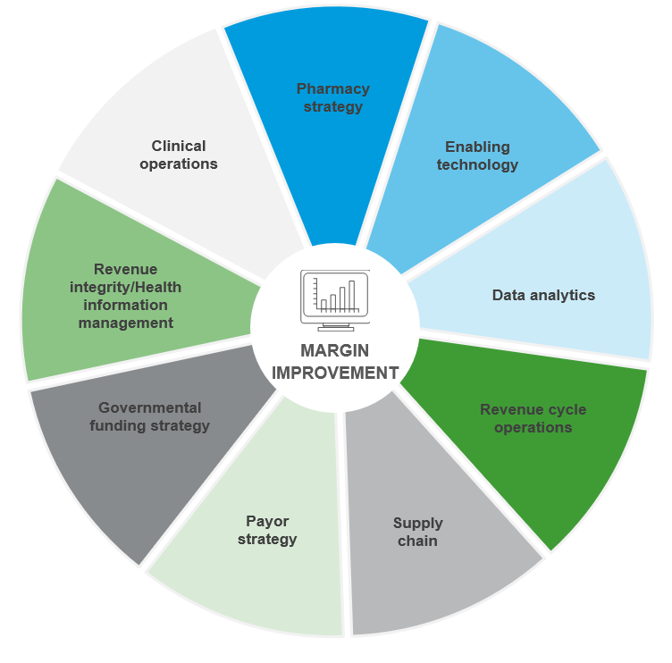
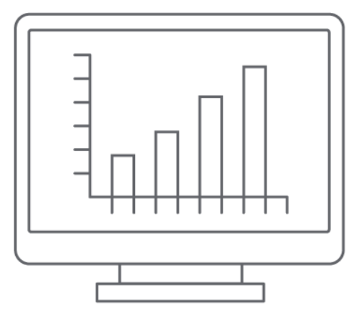
Data-guided Performance Improvement
Assess
Improve
Analyze Data
Create a Roadmap
Identify Opportunities
Quantify ROI potential
Evaluate
What worked, what didn’t
Sustain
Analytics to Monitor
Processes to Manage
Process Improvement
Targeted Analytics
Data-Guided, People Driven
Identify opportunities
Enterprise analytics
Pricing – Sriveni
Evaluate results
Targeted analytics

Slide 10
RSM Health Care Data Analytics: Approach
Data-driven
Use data to choose opportunities
Augment not replace
Leverage EMR and existing data warehouses and solutions
No new silos
Clients have too many tools and too much data already
Time to Value
Short term ROI, Long term sustainability
Solutions build on each other
Enterprise analytics
Identify opportunities
Evaluate results
Targeted analytics
Multi-phased agile approach
Deliver short term return on investment
Design data solutions which build a long-term foundation reusable for many analytics
Leverage & augment existing solutions
Utilize your data warehouse and business intelligence tools
Leverage your EMR (Epic, Cerner, Meditech)
Integrate sources & eliminate silos
Join EMR data with other sources such as patient experience, cost, registries
Create a single version of the truth, an enterprise analytics data source
Provide intuitive & interactive visualizations
Consistent look and feel
Reduce learning curve

Slide 11
Margin Transformation / Performance Improvement Categories to Evaluate to assess plus quantify ROI
LOS Opportunity
Discharge Efficiency
ED Boarder Time
Scheduling Efficiency
OR Block Utilization
Denials
CMI
Market share for specialties
Avoidable ED visits
Supply cost
Write-offs
Clinical variation
Supply waste
Blood utilization
ACO Metrics
Medicare Wellness
Readmissions
Observation Analytics
Payment Variation
Cash Collections
Authorizations
LWBS rates
Preference card analysis
Pharmacy costs
Automation Opportunities

Slide 12
Surgical Analytics
Increase revenue by scheduling and performing more surgeries
Reduce cost by eliminating staffed, empty operating rooms
Elevate patient experience by reducing wait times and improving quality
In

Slide 13
Surgical Efficiency
The perioperative suite is one of the busiest areas of the hospital, generates the most revenue and incurs the highest costs. Therefore, throughput and efficiency are vitally important.
Some of the important KPIs to track efficiency include:
On-time starts
Cancellations
Add-ons
Turnover and turnaround times
PACU boarding times
Case duration accuracy
Through analytics we can monitor the efficiency and also look for causes of inefficiencies.

Slide 14
Case Study: Operating Room Utilization
PROBLEM | GOAL | APPROACH | RESULTS
Operating rooms are sometimes empty and sometimes overbooked and open after hours. Some surgeons do not have enough operating room time available and others need more time. Disruption from COVID-19 has magnified these issues | Increase the amount of the operating room is full and decrease the amount of time the operating room is staffed and empty. Optimize block allocations to the changing needs of surgeon groups. | Track room utilization by hour to optimized staffed hours and volume. Analyze anesthesia usage and out-of-room staff utilization across surgical and procedural suites to monitor resource constraints. Analyze service and surgeon block utilization, including: block utilization, block releases, overbooks, unblocked utilization, scheduling patterns | 12% higher service block utilization 29% fewer empty staffed rooms 25% lower out of block minutes
Can also be applied to:
Endoscopy
Cath Lab
Electrophysiology
Interventional Radiology
Complex Imaging

Slide 15
Market Analytics
Increase revenue by growing services
Increase revenue by better referral management

Slide 16
Marketing Analytics
What providers should I hire? Or collaborate with?
Should I build an ambulatory surgical center?
Where should I invest?
Should I buy an orthopedic surgery group?
To answer these types of questions, we leverage claims data
For patients in my geography who go to other health systems, what specialists are they seeing? What procedures?
When my doctors refer to other providers, what specialists do they refer to?
How many orthopedic surgeries are performed in my area? What ancillary services are received?

Slide 17
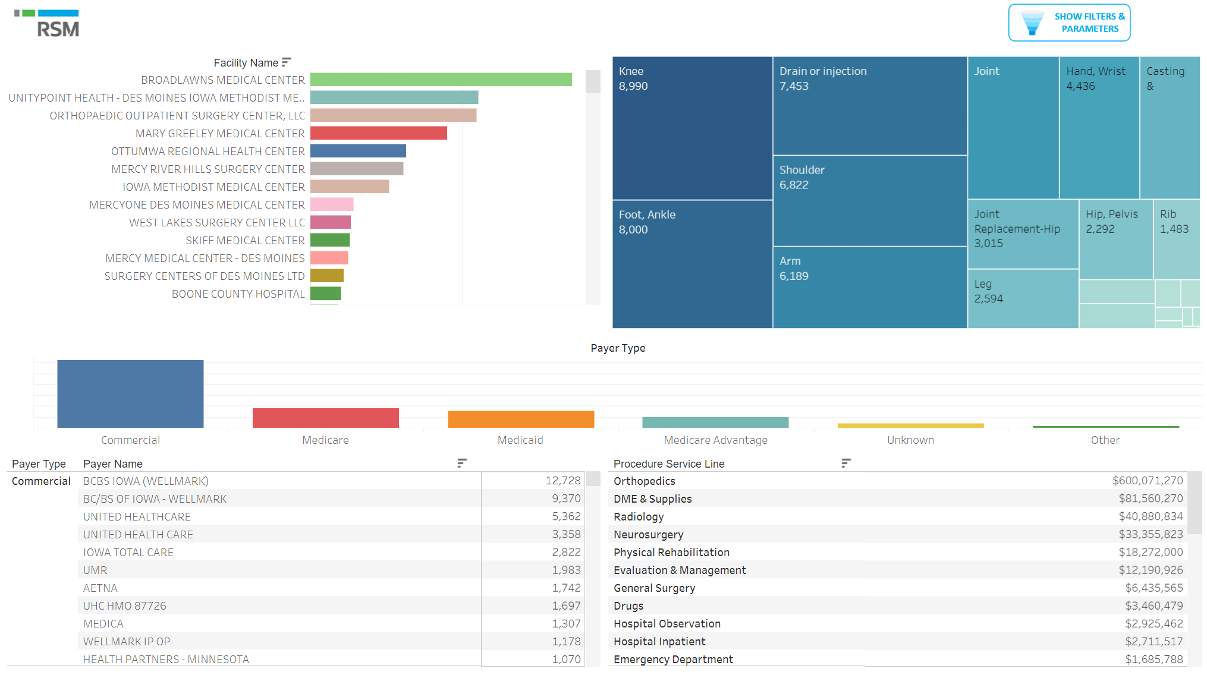
Marketing Analytics

Slide 18
Efficiency and Patient Movement
Reduce length of stay by optimizing patient movement and capacity management

Slide 19
Goals and Opportunities
Reduce length of stay
Reduce ED and PACU boarder time
Increase surgical and transfer volumes
Improve quality of care
Optimize staffing
How?
Reduce unnecessary bottlenecks and delays
Predict occupancy and patient needs
Know occupancy constraints ahead of time and mitigate them

Slide 20
Reducing Length of Stay
Length of stay is the biggest factor for inpatient cost
There are two fundamental ways to reduce LOS
Be more efficient
▪ Reduce Wait Times (ED boarder, PACU boarder, Patient Movement, Discharge)
▪ Optimize multi-disciplinary rounds
Cure patients faster
▪ Disease Care Paths ▪ Reduce Complications
The first step is to identify opportunities
What diseases have greatest length of stay
opportunity?
What units or processes have inefficiencies?
What complications are affecting length of stay?

Slide 21
Denial Analytics
Increase revenue by avoiding insurance denials
Increase revenue by appealing denials

Slide 22
Clinical Effectiveness
Reduce cost by reducing clinical variation

Slide 23
Reduce Clinical Variation, Save On Costs: DO MORE WITH LESS
Unwarranted clinical variation refers to medical practice pattern variation that cannot be explained by illness, medical need, or the dictates of evidence-based medicine. It is one of the causes of low value care often ignored by health systems.
Our challenge is to identify clinical variation and analyze if it is warranted.
Extract
Labs
Images
Stratify
Patient Details
Order Details
Categorize
Meds
Orders
Age, Diagnosis, Comorbidity
Provider
Service
Workflow
Location
Antibiotics
Opioids
X-Rays
Blood Products
Standardize
Per encounter
Per patient
Per Day

Slide 24
Patient Experience
Improving patient experience increases margin

Slide 25
Patient Experience and Health Equity: Background
90% of patients look at customer reviews before scheduling a provider.
Did you know that hospitals with high patient experience are more profitable? And that consumers with high satisfaction scores achieve better long-term outcomes?
Patients with high patient experience are 5 times more likely to return to a provider
96% of healthcare consumers perceive patient experience as important or very important
Hospitals with high patient experience have 2 – 3 times higher net margins
Long term patient outcomes and survival rates are 25% higher for satisfied patients
96% of online patient complaints center around customer service — not quality of care
People of color or lower income have greater infant mortality, lower life expectancy, lower patient experience scores, more health complications, and are less likely to be insured.
By 2024, most value-based care contracts will measure patient experience and health equity

Slide 26
Automation and AI
Automation and AI can increase productivity, reduce cost and increase efficiency

Slide 27
Top Healthcare Use Cases for AI
Azure Innovate Assessment
Responsible AI Governance Framework
Azure Private GPT X and GPT X Teams Application
Axe the Fax / Invoice processing
Patient Messaging Automation
Patient Chart Summarization
Analytics Data Enrichment, Curation, Classification, Embedding
Supply Chain Documents and Contract Summarization
Revenue Cycle, Coding, Prior Authorization and Claim Status
Appeals Automation
Call Center
ServiceNow Ticket Triage

Slide 28
Getting Started

Slide 29
C-Suite Margin Opportunities Daily Practice
Data, data and more data-is it meaningful? RSM utilizes “guided data”
Weekly executive meetings to ensure transparency and accountability
Need to spend time on growth, not just putting out daily fires
Identification of opportunities needs to be a collaborative approach
Prioritize projects that are low effort/high impact “low hanging fruit” first

Slide 30
Margin Improvement Resource Constraints
Tools and resources to monitor progress (Tableau, Power BI)
Data Analysis
Skill set - organization, project management, knowledge of workstream
Bandwidth
Technical skills (Epic SME)
Leadership accountability structures

Slide 31
Politics within your organization
Political influencers
Medical staff
Nursing
Board members
Silos
Departmental Leaders
Long standing contracts
Philanthropic Donors
Community business leaders
Change management and culture
“sacred cows”-everyone has them

Slide 32
How outside help can boost successful results in Margin Improvement and Transformation Projects
Unbiased approach and deep industry experience
Political roadblock navigation
High level project management and accountability structures
Data guided recommendations
Monitoring of results
Advanced technology capabilities
Automation recommendations
Provides bandwidth that organizations may not necessarily have

Slide 33
C-Suite determination of timelines and expectations
Project planning is a must with measurable outcomes and milestones
Workstreams must be organized in “bites” and strategically planned to align with activities within the organization
Baseline data should be identified and documented Milestones and results should be tracked and reported
Readiness to change should be assessed and a communication plan developed
C-suite should hold leaders accountable for deliverables
Sustainability plans should be part of the overall project planning
Evaluate and understand the capability and skill sets of the team. Determine if a third party is needed

Slide 34
Margin Transformation and Margin Improvement Model – Internal or External

Slide 35
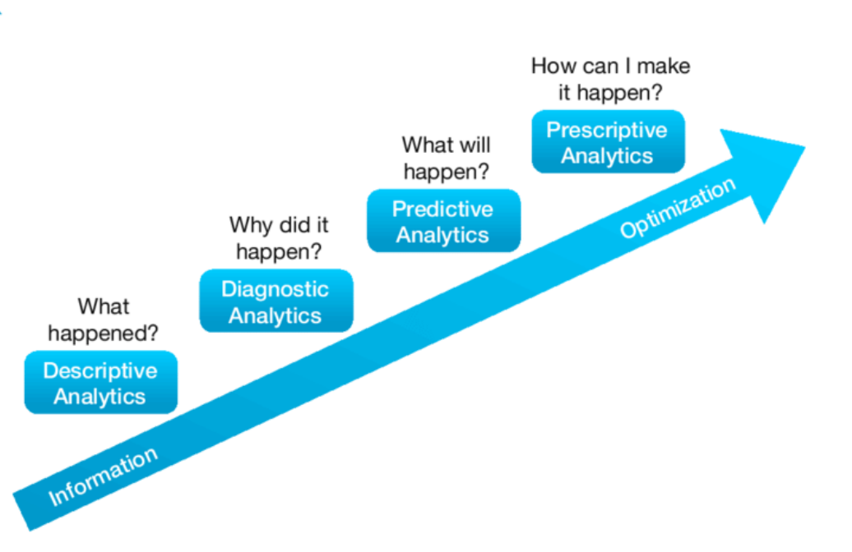
Iterative Model – Internal or External Approach
Analytics
Discrete Event Modeling
When and where are the bottlenecks?
Predictive Analytics
What will the occupancy be?
What actions or resources will help us improve?
Causal Analysis
What is causing delays?

Slide 36
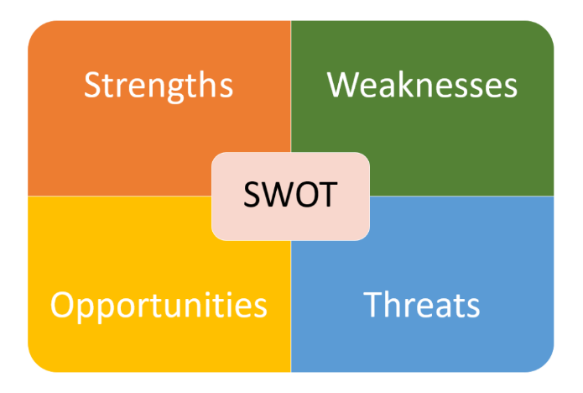
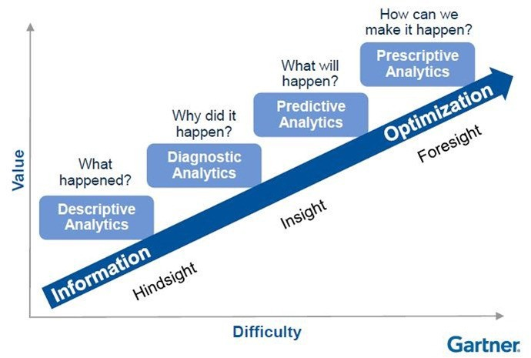
4-6 weeks
People
Technology
Process
Roadmap
Work together to create a strategic roadmap to become more data driven and get more value from analytics
Reporting
Analytics
User Adoption
Forecasting
Advanced Analytics
Interview Leaders
Understand needs, goals and pain points
Review Current State
Examine data architecture, sources, tools and solutions
Analyze Process
Understand current process for analytics requests, scoping, data definitions, prioritization and delivery
Efficiency & Scheduling
Referrals
Growth
MIPS
Care Management
Value Based Care

Slide 37
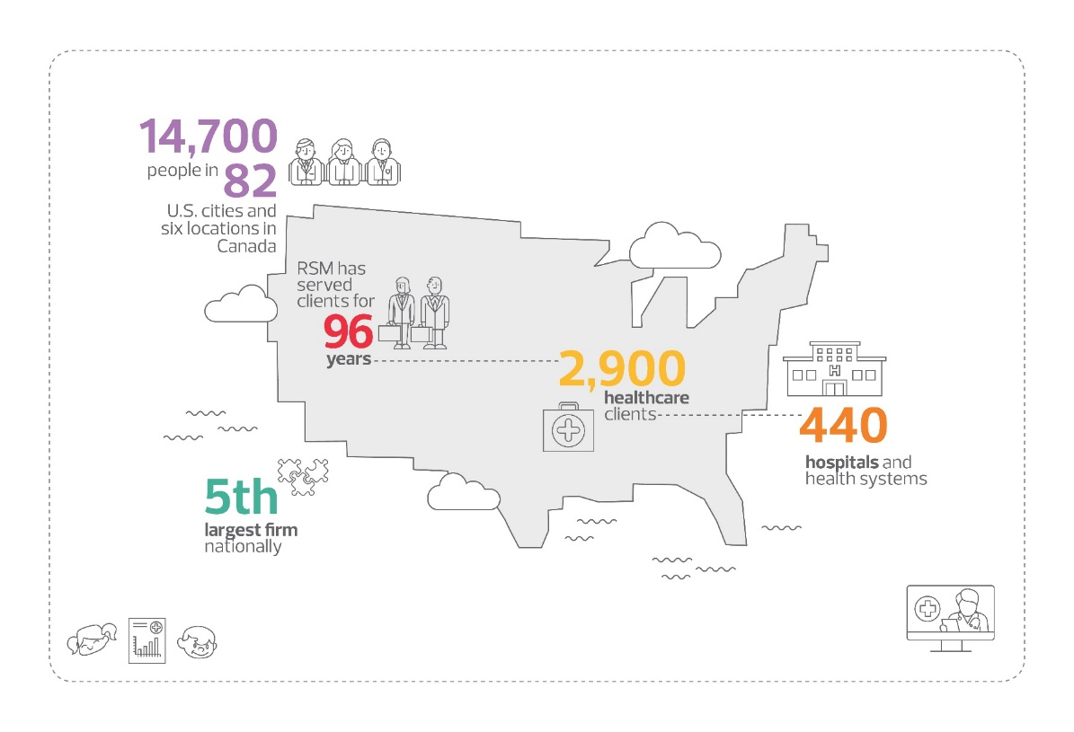
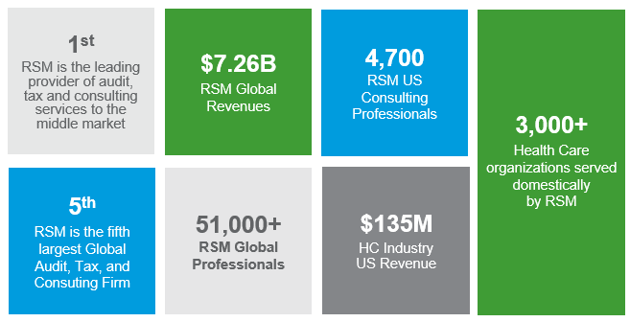
RSM Introduction – By the Numbers
Did you know?
OUR Healthcare verticals
+
MERGERS AND ACQUISITIONS
MARGIN IMPROVEMENT
PAYMENT STRATEGY
TECHNOLOGY & DIGITAL TRANSFORMATION
ENTERPRISE, OPERATIONAL, & REGULATORY RISK
CYBERSECURITY & DATA PRIVACY
AUDIT, TAX, & TECHNICAL ACCOUNTING

Slide 38
Our Health Care Capability Spectrum
Health Care Margin Transformation
Revenue Cycle
Clinical Operations
Supply Chain Optimization
Technology and Innovation
Government Funding Strategy
Revenue Cycle Operations
Governance, Organizational Structure And Human Capital
Performance And Production Management
Workflow Optimization
Denials Prevention
Operationalize Technology, Analytics And Automation
Revenue Integrity / HIM Management
Charge Master
Charge Capture And Reconciliation
Clinical Documentation Improvement
Coding Reviews And Education
Item Master Alignment
HIM Operations Standardization
Revenue Integrity Program Development
Clinical Operations
Perioperative Services
Emergency Department Process
Care Management And Patient Throughput
Labor Resource Management
Service Line & Business Strategy
Outpatient Services
Ambulatory/ Provider & Clinic Practices
Patient Experience
Data Analytics
Revenue Cycle
Revenue Integrity
Payment Strategy
Governmental Funding
Supply Chain
Clinical And Operations
Pharmacy Strategy
Executive Reporting
Governmental Funding Strategy
Cost Reporting / Reimbursement
Wage Index And Occupational Mix
Medicare Bad Debts
Disproportionate Share And Worksheet S-10 Uncompensated Care
Medicare Direct And Indirect Graduate Medical Education
Transfer Payments
Transplant Payments
Low-volume Adjustments
Provider Relief Funding
Medicaid Supplemental Payments
Medicare Elections And Designations
Pharmacy 340B
Supply Chain
Nonlabor Expense Reduction
Supply Chain Strategy
Group Purchasing Organization Market Assessment
Logistics – Inventory And Distribution
Purchased Services
Payor Strategy
Managed Care Strategy
Price Transparency
Net Revenue Modeling
Underpayment Recovery
Value-based, Population Health And Alternative Payment Models
Enabling Technology
EHR Integration/Optimization
Process Automation
Private Equity
ERP Integration/Optimization
Cloud Migration
Strategic Solutions
Internal Audit
Internal Audit Outsourcing
Internal Audit Risk Assessments
Quality Assurance Reviews
Work Plan Development
Internal Audit Project Support
M&A Due Diligence Support

Slide 39
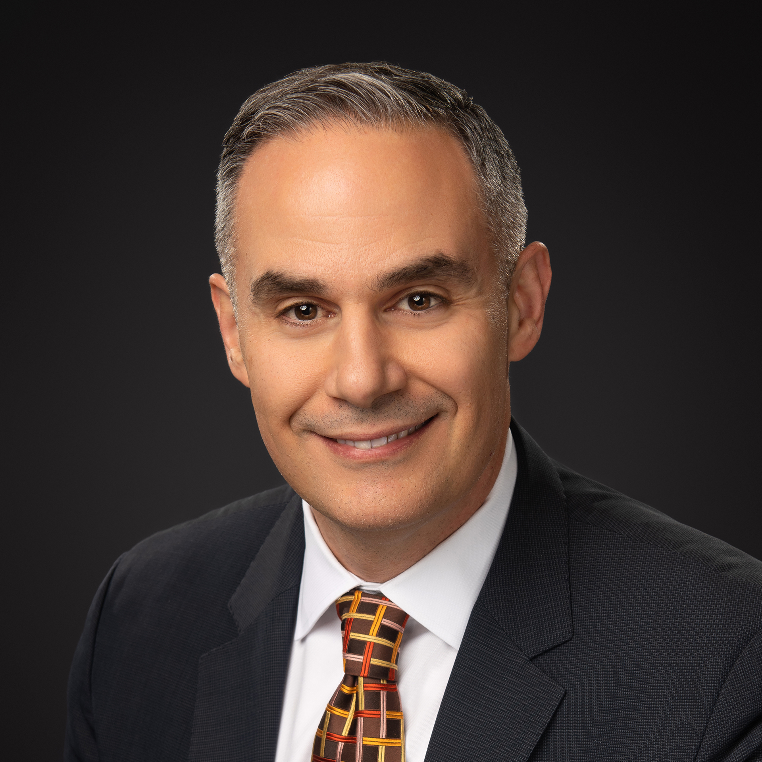
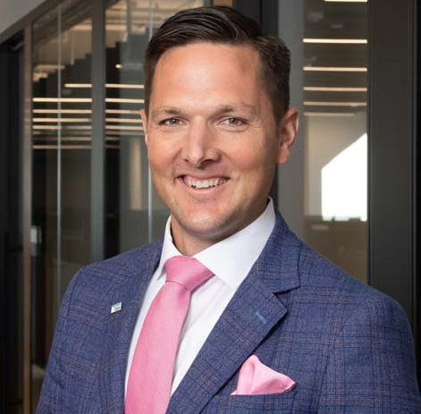
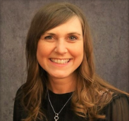
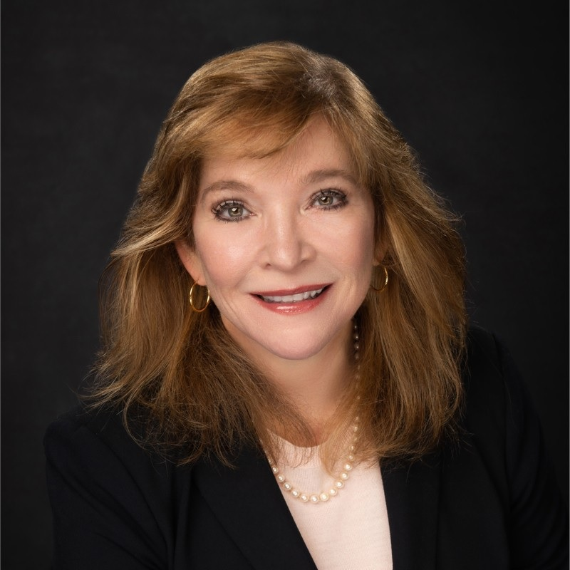
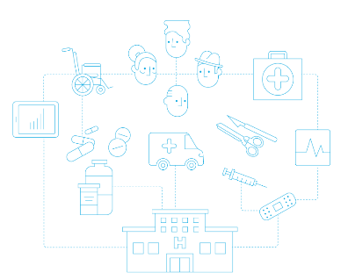
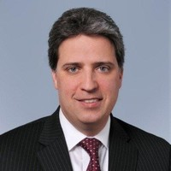
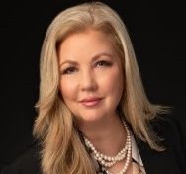
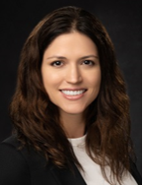
RSM Health Care Leaders
Industry Leader
Carlos Hernandez
Consulting Leader
Jim Sink
Enterprise Account
Richard Kes
CIO Advisory
Arvind Rao
Revenue Integrity
Crystal Estabrook
CEO Advisory
Beryl Ramsey Finlan
Health Care Consulting
Revenue Cycle Operations
Michael Brown
HC Data Analytics
Jamie McGlothlin
Government Funding Strategy
Jill Nelson
Enterprise Risk
Ryan Haggerty
Cyber Security
Greg Vetter
Clinical Operations
Val Howell
Supply Chain
Amber Downton
Finance & Accounting Transformation
Chris Zheng
Automation
Phil Martino
Mergers & Acquisitions
Jen Busse

Slide 40
QUESTIONS AND ANSWERS?
Let’s Connect
Let’s Connect
Thank you for your most valuable asset – Your Time
Jamie McGothlin​, PhD
jamie.mcglothlin@rsmus.com​
Beryl Ramsey Finlan, MBA, FACHE
beryl.ramsey@rsmus.com​
Val Howell, MSN, MBA,RN, NEA-BC
Val.howell@rsmus.com​

Slide 41
This document contains general information, may be based on authorities that are subject to change, and is not a substitute for professional advice or services. This document does not constitute assurance, tax, consulting, business, financial, investment, legal or other professional advice, and you should consult a qualified professional advisor before taking any action based on the information herein. RSM US LLP, its affiliates and related entities are not responsible for any loss resulting from or relating to reliance on this document by any person. Internal Revenue Service rules require us to inform you that this communication may be deemed a solicitation to provide tax services. This communication is being sent to individuals who have subscribed to receive it or who we believe would have an interest in the topics discussed.
RSM US LLP is a limited liability partnership and the U.S. member firm of RSM International, a global network of independent assurance, tax and consulting firms. The member firms of RSM International collaborate to provide services to global clients, but are separate and distinct legal entities that cannot obligate each other. Each member firm is responsible only for its own acts and omissions, and not those of any other party. Visit rsmus.com/aboutus for more information regarding RSM US LLP and RSM International.
RSM, the RSM logo and the power of being understood are registered trademarks of RSM International Association.
© 2023 RSM US LLP. All Rights Reserved.

