Slide 1
Navigating the Evolution of the HIPAA Era
Key Updates and Impacts Since 2013
J. Parker Zopp, Esq.
WV HFMA Fall Conference 2024
October 4, 2024

Slide 2
Presentation Overview
I. An Overview of HIPAA and its Applicability
The Legal Origins of HIPAA
Outlining Various HIPAA Rules
A Timeline of Key HIPAA Developments
Which Entities are Subject to HIPAA?
Who are Business Associates?
What is Protected Health Information?
HIPAA Criminal and Civil Penalties
II. HIPAA Privacy Rule to Support Reproductive Health Care Privacy
Defining “Reproductive Health Care”
Modification to the Definition of “Public Health”
Uses and Disclosures of Reproductive Health Care PHI
Unpacking the “Rule of Applicability”
New Attestation Requirement for Certain Types of Uses and Disclosures
Required Updates to the Notice of Privacy Practices
Crossover With the Part 2 Rule
2

Slide 3
I. An Overview of HIPAA and Its Applicability: Key Concepts and Regulations
3

Slide 4
The Legal Origins of HIPAA
“HIPAA” refers to the Health Insurance Portability and Accountability Act of 1996, Pub. L. 104-191, which was enacted on August 21, 1996.
One of HIPAA’s primary purposes was to protect health insurance coverage for workers and their families who change or lose jobs.
However, standards for privacy and security were also needed because of the increasing exchange of personal health information between different kinds of entities in a diverse health care marketplace.
Administrative Simplification Provisions - Sections 261 through 264 of HIPAA requires the Secretary of the U.S. Department of Health and Human Services (HHS) to publicize standards for the electronic exchange, privacy, and security of health information.
Image Source:
AP Photo. https://www.modernhealthcare.com/article/20160813/MAGAZINE/308139964/at-20-is-hipaa-hitting-its-stride-or-is-it-over-the-hill
4

Slide 5
Outlining Key HIPAA Rules
The Security Rule
Establishes a national set of security standards for protecting certain health information that is held or transferred in electronic form. Operationalizes the protections contained in the Privacy Rule by addressing the safeguards that covered entities must be put in place to secure individuals’ electronic personal health information (ePHI).
45 C.F.R Part 160; 45 C.F.R. part 164 Subparts A and C.
The Privacy Rule
Addresses the use and disclosure of individuals’ personal health information (PHI) by covered entities and provides standards for individuals' privacy rights.
45 C.F.R Part 160; 45 C.F.R. part 164 Subparts A and E.
The Breach Notification Rule
Requires HIPAA covered entities and their business associates to provide notification following a breach of unsecured PHI.
45 C.F.R Part 160; 45 C.F.R. part 164 Subparts A and D.
5

Slide 6
HIPAA Signed Into Law
HIPAA Privacy Rule Compliance Required
HIPAA Security Rule Compliance Required
HITECH Act Signed Into Law
HIPAA Omnibus Final Rule Compliance Required
21st Century Cures Act is Signed Into Law
Effective Date of Certain HIPAA-Part 2 Alignment
Breach Notification Rule Compliance Required
HIPAA Privacy Rule to Support Reproductive Health Care Privacy Becomes Effective
Timeline of Key Developments
August 1996
April 2003
April 2005
February 2009
September 2009
September 2013
December 2016
April 2024
June 2024
6

Slide 7
Which Entities are Subject to the HIPAA Rules?
Covered Entities
Health Plans
Healthcare Clearinghouses
Healthcare Providers Who Submit Health Information in Electronic Form in Connection with a Covered Transaction*
See 45 C.F.R. 160.103.
*Examples include transmissions of information such as claims, premium payments, benefit eligibility inquiries, referral authorization requests, and other transactions for which HHS has established standards via regulation.
7

Slide 8
Business Associates
The HIPAA Rules also detail regulations pertaining to “business associates” of covered entities.
Who is a Business Associate?
While the full scope of business associates are detailed at 45 C.F.R. § 160.130, HHS summarizes a business associate as “a person or entity that performs certain functions or activities that involve the use or disclosure of [PHI] on behalf of, or provides services to, a covered entity.”
In addition to using or disclosing PHI, business associates can create, receive, maintain, or transmit PHI on behalf of the covered entity in accordance with the Privacy Rule. See 45 C.F.R. § 160.502(a)(3), (e).
Members of covered entity’s workforce are not included as business associates and are instead included as part of the covered entity..
Written Assurances
Under 45 C.F.R § 164.502(e), business associates must enter into a Business Associate Agreement (“BAA”) with covered entities that obligate business associates to appropriately safeguard the PHI it receives or creates on behalf of the covered entity.
BAAs must establish the permitted and required uses and disclosures of PHI by the business associate and fulfill the other requirements of 45 C.F.R § 164.504(e) that detail obligations of each party that pertain to topics including, but not limited to, the following: reporting breaches of unsecured health information, providing an accounting of disclosures, and making books and records available for compliance purposes.
8

Slide 9
HHS Examples of Business Associate Activities and Services
Claims processing or administration;
Data analysis;
Processing or administration;
Utilization review;
Quality assurance;
Billing;
Benefit management;
Practice management;
Repricing
Legal;
Actuarial;
Accounting;
Consulting;
Data aggregation;
Management;
Administrative;
Accreditation; and
Financial.
See 45 C.F.R. § 160.130;
https://www.hhs.gov/hipaa/for-professionals/privacy/guidance/business-associates/index.html.
9

Slide 10
Exceptions to the Business Associate Standard
(1) Disclosures from covered entities to health care providers for treatment.
(2) Disclosures to a health plan sponsor (e.g., an employer) by a group health plan, or by the health insurance issuer that provides the health insurance benefits or coverage for the group health plan, provided certain criteria are met.
(3) Where authorized, for eligibility or enrollment purposes, the collection and sharing of PHI by public benefits program health plan (e.g., Medicare) and a government agency that is not the one administering the health plan (e.g., the Social Security Administration).
(4) Disclosures from covered entities performing certain functions in coordination with an “organized health care arrangement” as defined.
See 45 C.F.R. § 160.130.
10

Slide 11
Protected Health Information (PHI)
What is Included as PHI?
PHI includes all “individually identifiable health information” held or transmitted by a covered entity or its business associate, in any form or media, whether electronic, paper, or oral.
Individually Identifiable Health Information - information, including demographic data, that:
(1) Is created or received by a health care provider, health plan, employer, or health care clearinghouse; and
(2) Relates to the past, present, or future physical or mental health or condition of an individual; the provision of health care to an individual; or the past, present, or future payment for the provision of health care to an individual; and
(i) That identifies the individual; or
(ii) With respect to which there is a reasonable basis to believe the information can be used to identify the individual.
When combined with this health information, individually identifiable health information includes many common identifiers (e.g., name, address, birth date, SSN).
Excluded from the Definition of PHI:
Employment records held by an employer.
Certain education records under 20 U.S.C. § 1232g.
Individually identifiable health information of a person deceased more than 50 years.
See 45 C.F.R. § 160.103

Slide 12
Criminal Penalties for HIPAA Violations
Criminal penalties for HIPAA violations vary according to the motive for the offense.
A person who knowingly and wrongfully uses or causes to be used, obtains, or discloses individually identifiable health information can be fined up to $50,000 and/or imprisoned for up to a year.
If the offense is committed under false pretenses, the fine increases to a $100,000 maximum and/or imprisonment up to 5 years.
If the offense is committed with the intent to sell, transfer, or use individually identifiable health information for commercial advantage, personal gain, or malicious harm, the fine increases to $250,000 maximum and/or imprisonment up to 10 years.
See 42 U.S.C. 1320d-6.

Slide 13
Civil Monetary Penalties (CMPs) for HIPAA Violations
Tier | Level of Knowledge/Culpability | Minimum Penalty | Maximum Penalty | Maximum Penalty Per Year (Cap)
Tier 1 | Lack of Knowledge, Reasonable Due Diligence Would Not Have Discovered | $141 | $71,162 | $2,134,831
Tier 2 | Reasonable Cause and Not Willful Neglect | $1,424 | $71,162 | $2,134,831
Tier 3 | Willful Neglect (But Violation is Corrected Within 30 Days) | $14,232 | $71,162 | $2,134,831
Tier 4 | Willful Neglect, Not Corrected Within 30 Days | $71,162 | $2,134,831 | $2,134,831
Subject to annual inflation adjustments.
See 42 U.S.C. 1320d-5; 45 C.F.R. § 160.404;
89 Fed. Reg. 64815, 64822 (published August 8, 2024).
13

Slide 14
II. HIPAA Privacy Rule to Support Reproductive Health Care Privacy
14

Slide 15
The Privacy Rule
Background:
HIPAA required HHS to issue privacy regulations governing identifiable health information if Congress did not enact privacy legislation within three years of HIPAA’s enactment.
Because Congress did not enact such legislation, per Pub. L. 104-191 § 264(c)(1), HHS had to develop the Standards for Privacy of Individually Identifiable Health Information Rule (“Privacy Rule”), which it published on December 28, 2000.
Function:
Addresses the use and disclosure of individuals’ PHI by covered entities and provide standards for individuals' privacy rights.
General Rules – Describes who may access information and what information may be disclosed.
Enforcement Agency:
The Office for Civil Rights (OCR) within HHS.
15

Slide 16
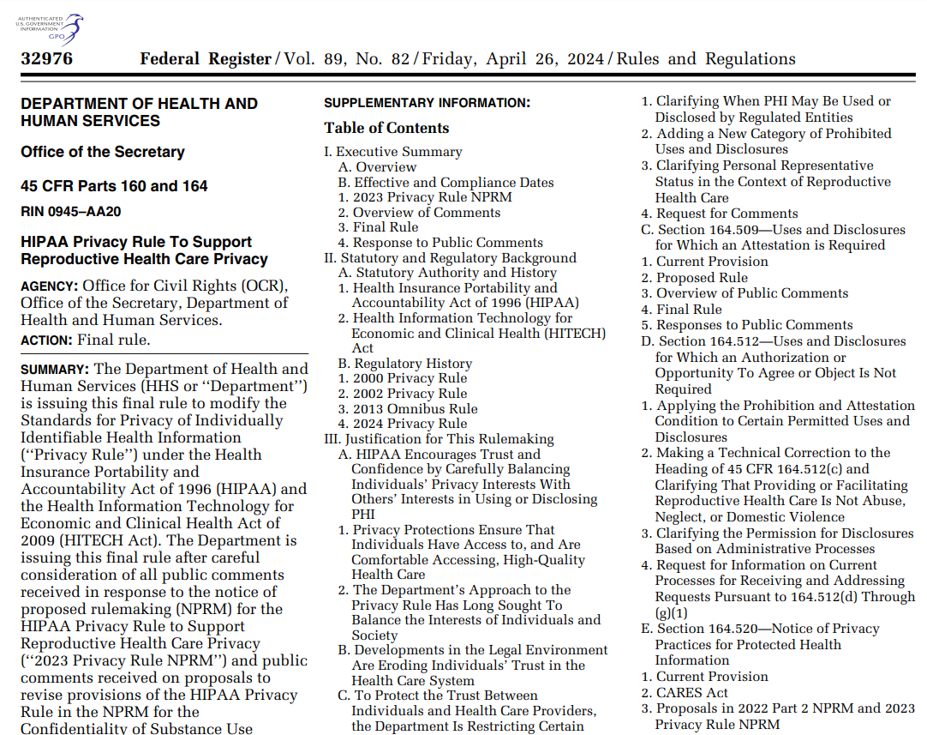
Update for Reproductive Health Care Privacy
On April 22, 2024, OCR issued a Final Rule entitled HIPAA Privacy Rule to Support Reproductive Health Care Privacy (“Reproductive Health Rule”). The Reproductive Health Rule strengthens the HIPAA Privacy Rule by prohibiting the use and disclosure of PHI related to lawful reproductive health care in certain circumstances.
HHS has referenced that this rule is a direct response to the U.S. Supreme Court’s ruling in Dobbs v. Jackson Women’s Health Organization (2022) and consistent with HIPAA’s statutory mandate.
Effective Date – June 24, 2024
Compliance Date – December 23, 2024 (except for compliance related to the changes to the Notice of Privacy Practices)
Image Source: https://www.govinfo.gov/content/pkg/FR-2024-04-26/pdf/2024-08503.pdf
See 89 Fed. Reg. 32976.
16

Slide 17
NEW DEFINTIONS UNDER THE REPRODUCTIVE HEALTH RULE

Slide 18
Existing Definition - “Health Care”
“Health care means care, services, or supplies related to the health of an individual. Health care includes, but is not limited to, the following:
(1) Preventive, diagnostic, therapeutic, rehabilitative, maintenance, or palliative care, and counseling, service, assessment, or procedure with respect to the physical or mental condition, or functional status, of an individual or that affects the structure or function of the body; and
(2) Sale or dispensing of a drug, device, equipment, or other item in accordance with a prescription.”
45 C.F.R. § 160.103

Slide 19
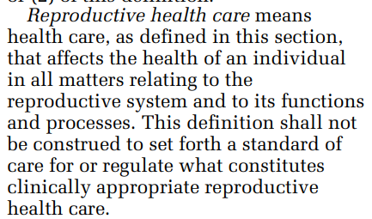
Defining “Reproductive Health Care”
Definition is not limited to only health care that is determined to be appropriate by a health care professional. Instead, the definition also applies to circumstances where an individual determines whether the health care that person receives is appropriate (e.g., over-the-counter contraceptives).
The definition is intended to be broad.
Information meeting the definition is not sufficient for information about such health care to be protected under HIPAA – it still must be PHI.
45 C.F.R. § 160.103
See 89 Fed. Reg. at 33005.
19

Slide 20
Reproductive Health Care Examples
Care, Services, and Supplies Including, But Not Limited, to the Following:
“Contraception, including emergency contraception;
Preconception screening and counseling;
Management of pregnancy and pregnancy-related conditions, including pregnancy screening, prenatal care, miscarriage management, treatment for preeclampsia, hypertension during pregnancy, gestational diabetes, molar or ectopic pregnancy, and pregnancy termination;
Fertility and infertility diagnosis and treatment, including assisted reproductive technology and its components (e.g., in vitro fertilization (IVF));
Diagnosis and treatment of conditions that affect the reproductive system (e.g., perimenopause, menopause, endometriosis, adenomyosis); and
Other types of care, services, and supplies used for the diagnosis and treatment of conditions related to the reproductive system (e.g., mammography, pregnancy-related nutrition services, postpartum care products).”
See 89 Fed. Reg. at 33006.
20

Slide 21
Defining “Public Health”
“Public health, as used in the terms ‘public health surveillance,’ ‘public health investigation,’ and ‘public health intervention,’ means population-level activities to prevent disease in and promote the health of populations. Such activities include identifying, monitoring, preventing, or mitigating ongoing or prospective threats to the health or safety of a population, which may involve the collection of protected health information. But such activities do not include those with any of the following purposes:
(1) To conduct a criminal, civil, or administrative investigation into any person for the mere act of seeking, obtaining, providing, or facilitating health care.
(2) To impose criminal, civil, or administrative liability on any person for the mere act of seeking, obtaining, providing, or facilitating health care.
(3) To identify any person for any of the activities described at paragraphs (1) or (2) of this definition.”
45 C.F.R. § 160.103.

Slide 22
Defining “Public Health”
“This definition does not prevent disclosures of PHI by covered entities to public health authorities for public health activities that have long been permitted under the Privacy Rule.” See 89 Fed. Reg. At 33001.
HHS emphasizes that public health activities related to surveillance, investigation, or intervention are those that aim to improve the health of a population. However, the agency makes it clear that such activities can include interventions involving specific individuals.
HHS commentary stresses the difference between public health activities and criminal investigations (which are primarily focused on imposing liability)
Public health reporting is typically not enforced through criminal laws.
See 89 Fed. Reg. At 33001-03.

Slide 23
Uses and Disclosures of Reproductive Health Care PHI

Slide 24
Uses and Disclosures of PHI: General Rules (The “Prohibition”)
A covered entity or business associate may not use or disclose PHI for any of the following activities:
(1) To conduct a criminal, civil, or administrative investigation into any person for the mere act of seeking, obtaining, providing, or facilitating reproductive health care;
(2) To impose criminal, civil, or administrative liability on any person for the mere act of seeking, obtaining, providing, or facilitating reproductive health care;
(3) To identify any person for any purpose described in paragraphs (1) or (2) above.
See 45 C.F.R. § 164.502(a)(5)(iii)(A).

Slide 25
Uses and Disclosures of PHI: Limits on the Prohibition
HHS clarified that that where a requestor identifies a legal basis beyond the specified purposes (seeking to investigate or impose liability for reasons articulated), the Prohibition does not apply. There, uses and disclosures could be made pursuant to the Privacy Rule (e.g., legal instruments such as warrants and subpoenas may still be required).
Examples
A covered entity may use or disclose PHI to a health oversight agency that is investigating whether reproductive health care was actually provided or appropriately billed in connection with a claim for such services or investigating substandard medical care. However – improper claims or substandard medical care cannot be used as a pretext to circumvent the Prohibition.
See 45 C.F.R. § 164.502(a)(5)(iii)(A);
89 Fed Reg. 33012.

Slide 26
Unpacking the Rule of Applicability
The Prohibition only applies where the covered entity or business associate has reasonably determined:
Care was legal in the state where provided;
(2) Care was legal under federal law; or
(3) the “Presumption” applies.
The Presumption means that the care provided by another person is presumed lawful unless the covered entity or business associate has either:
Actual knowledge of illegality; or
Factual information from the requestor that demonstrates a “substantial factual basis” of illegality.
See 45 C.F.R. § 164.502(a)(5)(iii)(B)-(C).

Slide 27
Rule of Applicability – The Reasonableness Determination
The Rule of Applicability requires that regulated entities make a reasonableness determination about the lawfulness of the applicable reproductive health care provided.
Rule - To determine reasonableness, the regulated entity must determine whether it would be reasonable for a similarly situated regulated entity to determine that one or more of the Rule of Applicability's conditions applies and evaluate the facts and circumstances under which the reproductive health care was provided.
Examples of Facts and Circumstances:
The individual’s diagnosis and prognosis;
The time such health care was provided;
The location the health care was provided; and
The particular provider who provided the health care.
See 45 C.F.R. 164.502(a)(5)(iii)(B)(1)-(3);
89 Fed. Reg. at 33013.

Slide 28
Applying the Presumption - Illustration #1
A hospital has PHI about the provision of reproductive health care provided by a different facility. If requested to use or disclose this PHI for a purpose to which the Prohibition may apply, the hospital is not expected to research whether the care was lawful, consult an attorney, or even review the individual’s PHI. Instead, the Presumption allows the hospital to limit the review to the information the requestor has supplied. In practice, this means that the hospital will presume lawfulness unless that presumption is rebutted.
See 45 C.F.R. 164.502(a)(5)(iii)(B)(1)-(3);
89 Fed. Reg. at 33014-15.

Slide 29
Applying the Presumption - Illustration #2
A law enforcement official in State A issues a subpoena to a hospital in State A (the “Hospital”) to request the PHI of an individual from State A who is suspected of obtaining reproductive health care in State B that would have been illegal in State A.
The Hospital did not provide this health care nor did the individual provide information about the health care to the Hospital.
At the time of the subpoena, the Hospital is not treating the individual, nor is the individual otherwise at the Hospital.
The Hospital does not have actual knowledge that the health care was provided was illegal nor does the information supplied by the official demonstrate a “substantial factual basis” that the health care was illegal (e.g., consider an anonymous report being supplied).
Outcome: The Hospital would be prohibited from disclosing the requested PHI unless (1) the law enforcement official provides additional information to overcome the Presumption; and (2) the Privacy Rule permits the disclosure otherwise, including the receipt of an Attestation (discussed later).
See 45 C.F.R. 164.502(a)(5)(iii)(B)(1)-(3);
89 Fed. Reg. at 33014-15.

Slide 30
Attestation Requirement
Rule – Under the newly added 45 C.F.R. §164.509, a regulated entity may not use or disclose PHI potentially related to reproductive health care for purposes specified in § 164.512(d) [health oversight activities], (f)[law enforcement purposes], or (g)(1) [Information about decedents – coroners and medical examiners], without obtaining a signed attestation from the requestor that the use or disclosure does not violate the Prohibition (collectively, the “Attestation”).
§ 164.512(d) [public health activities] is not included in this list – but the definition of “public health” excludes purposes that violate the Prohibition.
Business Associate Adherence - Business Associates are directly liable for compliance with the Attestation, regardless of whether compliance is explicitly included in a BAA.
Failure to Comply – Use/disclosure without an Attestation or use/disclosure based on a defective attestation could result in an HHS enforcement action.
See 45 C.F.R. 164.509;
89 Fed. Reg. at 33029.

Slide 31
Implementing the Attestation Requirement
Among other requirements, a valid Attestation must:
(1) Include a description of the information requested that identifies the information in a specific fashion, including one of the following:
(1) The name of the individual whose PHI is sought, if practicable; or
(2) If not practicable, the class of individuals whose PHI is sought;
(2) –(3) Include the name or other specific ID of the persons (or class) who are requested to make the use or disclosure and the name or other specific ID of the persons (or class) to whom the use or disclosure is to be made;
(4) Include a clear statement that the use or disclosure is not for a purpose that violates the Prohibition;
(5) Include a statement that a person may be subject to criminal penalties under 42 U.S.C. 1320d-6 if that person knowingly obtains or discloses individually identifiable information in violation of HIPAA;
(6) Be signed and dated by the requestor of the PHI (or a representative);
(7) Be written in plain language.
See 45 C.F.R. 164.509(c).

Slide 32
Additional Attestation Considerations
Response is Not Mandatory: Regulated entities are permitted, but not required to respond to law enforcement request for PHI where the purpose is not one that is prohibited.
No Compound Attestation: The Attestation may not be combined with any other document, except to the extent where such other document is needed to satisfy other requirements. See 45 C.F.R. 164.509(b)(3).
No Additional Required Elements: The Attestation may not contain any element or statement not required by the regulation. See 45 C.F.R. 164.509(b)(2)(ii).
Another Reasonability Determination: One notable element of a defective Attestation under § 164.509(b)(v) is that a “reasonable covered entity or business associate in the same position would not believe that the [A]ttestation is true with respect to [the requirement that the requestor states that the use/disclosure does not violate the Prohibition.”
Material Misrepresentations: If a regulated entity later discovers information that reasonably shows that any representation made in the Attestation is materially false, it must stop making the requested use or disclosure. See 45 C.F.R. 164.509(d).
Maintenance of Copies: The Attestation and its supporting documentation is subject to the administrative requirement at § 164.530(j) to maintain documentation for six years from the date of its creation or the date when it was last in effect – whichever was later.

Slide 33
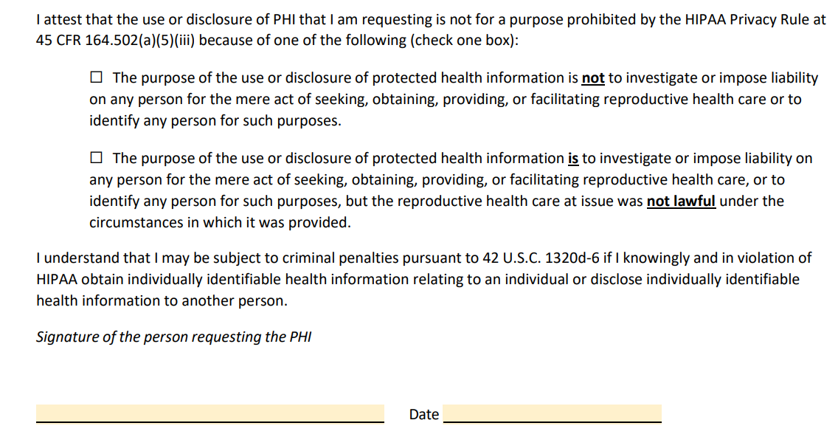
HHS Model Attestation
For a Requested Use or Disclosure of PHI Potentially Related to Reproductive Health Care
Image Source: https://www.hhs.gov/sites/default/files/model-attestation.pdf
33

Slide 34
Examples of Questions When Analyzing a Potential Use or Disclosure
Does this use or disclosure involve PHI related to reproductive health care?
Would the use or disclosure be subject to the Prohibition? Does the Rule of Applicability apply?
Who provided the reproductive health care at issue? If another provider supplied the reproductive health care, can the Presumption be overcome?
Is an Attestation required for this use or disclosure?

Slide 35
Recent Lawsuit
The state of Texas filed a complaint against HHS on September 4, 2024, in the U.S. District Court for the Northern District of Texas - State of Texas v. United States Department of Health and Human Services et al. (N.D. Tex. 2024).
At Issue – Texas believes that the Reproductive Health Rule improperly strips law enforcement officials of the ability to determine whether reproductive health care services were administered illegally and that it and the Privacy Rule impede states’ ability to investigate and enforce state laws.
Legal Argument - The attorney general’s office argues that HHS regulations exceed statutory authority and are arbitrary and capricious.
Relief Requested - Texas is seeking declaratory and injunctive relief against the HHS regulations.

Slide 36
Changes to Notice of Privacy Practice (NPP) Requirements

Slide 37
Required Updates to NPPs for Reproductive Health Care
NPPs must include a description (and at least one example) of the types of uses and disclosures relating to reproductive health:
That are subject to the Prohibition;
That require an Attestation under the new Reproductive Health Rule.
Additionally, NPPs must include a statement that provides
notice of the potential that PHI disclosed pursuant to the
Privacy Rule may be subject to redisclosure, which means
that it could lose its protection of the Privacy Rule.
Deadline to Update: February 16, 2026
See 45 C.F.R. § 164.520(b)(ii)(F)-(H).

Slide 38
Required Updates to NPPs for Part 2
Per the Reproductive Health Rule, for covered entities that create or maintain Part 2 records, changes include (but are not limited to):
(1) Notice Requirements - Under 45 C.F.R. § 164.520(a)(2), the covered entity must provide notice to individuals of the ways in which that covered entity may use and disclose such Part 2 records, and of the individual’s rights and the covered entities’ responsibilities with respect to such records.
(2) Plain Language Requirement - Under § 164.520(b)(1), the covered entity must provide an NPP that is written in plain language and that includes the required elements.
(3) Disclosure for Proceedings – Under § 164.520(b)(1), 164.520(b)(1)(iii), the NPP must provide notice that a Part 2 record, or testimony relaying the content of such record, may not be used or disclosed in a civil, criminal, administrative, or legislative proceeding against the individual absent written consent from the individual or a court order.

Slide 39
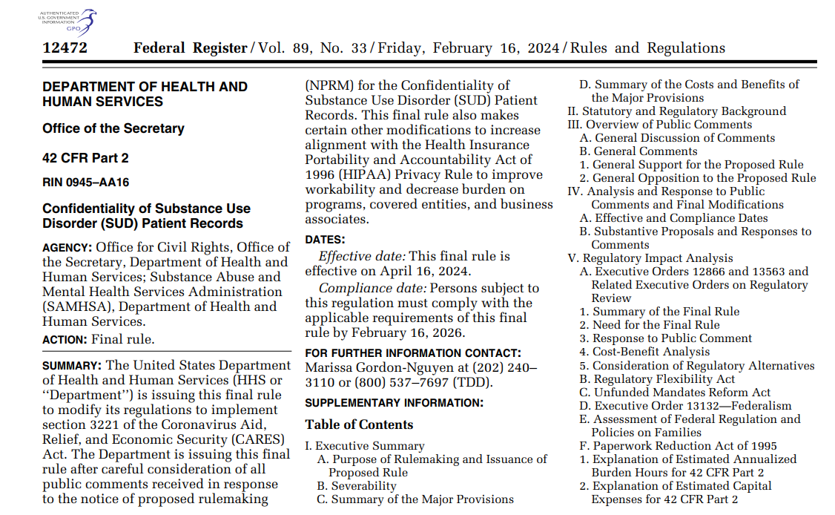
Confidentiality of Substance Use Disorder (SUD) Patient Records Final Rule
HHS published this final rule (the “Part 2 Rule”) on February 16, 2024, to modify its regulations to implement section 3221 of the Coronavirus Aid, Relief, and Economic Security (CARES) Act (signed March 27, 2020)
The Part 2 Rule has several interactions with HIPAA, as Congress sought to align Part 2 and HIPAA on several aspects.
The Part 2 Rule also overlaps with the Reproductive Health Rule on NPP requirements.
Effective Date – April 16, 2024
Compliance Date – February 16, 2026
Image Source: https://www.govinfo.gov/content/pkg/FR-2024-02-16/pdf/2024-02544.pdf
See 89 Fed. Reg. 12472

Slide 40
Reproductive Health Rule Crossover With Part 2
Section 3221(i) of the CARES Act directed HHS to modify the NPP provisions to include new requirements for covered entities covered entities that are Part 2 programs and covered entities that receive Part 2 records from a Part 2 program.
The Part 2 Final Rule noted that HHS was not finalizing the proposed modifications to the NPP provisions at that time but that it planned to do so in a future HIPAA final rule.
So covered entities would not need to revise their NPPs twice within short period of time, HHS stated in the Part 2 Rule that it would exercise enforcement discretion related to the requirement that covered entities update their NPPs whenever material changes are made to privacy practices until the compliance date established by a future HIPAA final rule – which became the Reproductive Health Rule.

Slide 41
Overview - 42 C.F.R. Part 2
WHAT IS 42 CFR PART 2?: 42 CFR Part 2 (“Part 2”) protects “[r]ecords of the identity, diagnosis, prognosis, or treatment of any patient which are maintained in connection with the performance of any program or activity relating to [SUD] education, prevention, training, treatment, rehabilitation, or research, which is conducted, regulated, or directly or indirectly assisted by any department or agency of the United States.”
PURPOSE: Confidentiality protections help address concerns that discrimination and fear of prosecution deter people from entering treatment for SUD.
See § 42 U.S.C 290dd-2.

Slide 42
Part 2 Rule Highlights
42 C.F.R. § 2.3 – Penalties
Applies HIPAA criminal and penalties to Part 2 violations.
42 C.F.R. § 2.11 – SUD Counseling Notes
Creates a new definition for a SUD clinician’s notes that creates protections analogous to those in HIPAA for psychotherapy notes. Also expressly states that segregating or segmenting Part 2 records is not required.
42 C.F.R. § 2.16 - Breach Notification
Applies the same requirements of the HIPAA Breach Notification Rule to breaches of record under Part 2. Also now permits disclosures without patient consent to public health authorities provided that the records are de-identified.
42 C.F.R. § 2.31 – Consent Requirements
Finalizes the proposed alignment of the content requirements for Part 2 written consent with the content requirements for a valid HIPAA authorization. Also adds an express requirement for separate consent for use and disclosure of records in civil, criminal, administrative, or legislative proceedings.
42 C.F.R. § 2.32 - Single TPO Consent
Allows a single consent for all future uses and disclosures for treatment, payment, and health care operations (TPO). Also allows HIPAA covered entities and business associates that receive records under this consent to redisclose the records in accordance with HIPAA regulations. Further requires that each disclosure made with patient consent include a copy of the consent or a clear explanation of the scope of the consent.
42

Slide 43
Disclaimer
Views are my own and not necessarily those of my firm, do not constitute official guidance from my firm, and are not intended to serve as a statement of the law or as an official opinion or advice.

Slide 44
Connect With Me!
J. Parker Zopp
Associate
(304) 340-1341
(304) 972-7746
parker.zopp@jacksonkelly.com
500 Lee Street East | Charleston, WV 25301-3202

