Slide 1
Aligning revenue cycle value streams
Reduce leakage and improve margins

Slide 2
How is it going?

Slide 3
Why is it so hard?
We’re swimming upstream!
Shrinking margins
Staff Shortages
Increasing denials
Regulatory pressures
Market pressures
Value based reimbursement/bundles
Complicated revenue cycle processes

Slide 4
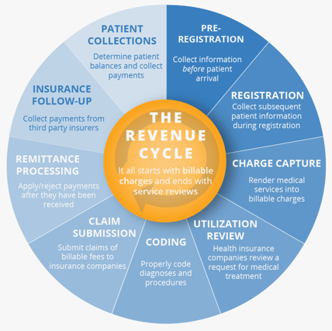
Typical process – on paper
Seems streamlined
Ideally, one flows into the other
All work in harmony

Slide 5
Closer to Reality

Slide 6
Notes:
Actual reality

Slide 7
Revenue Landscape
A Quick review

Slide 8
A Look Back
2022:
Worst year on record for hospital finances
Operating losses were unprecedented
50% of hospitals finished 2022 with negative margins
Kauffman Hall reported operating margins were 0.3%
Improved in 2023 to 1.2%
According to Crowe RCA, 2022 was highest year for take backs since they began tracking
2023:
4x more external audits compared to previous years
Grew 23% compared to 2022
Inpatient grew by 32%
170% increase in hierarchical conditions coding audits
300% DRG audit increase
54% specialty drug increase
MA plans crossed threshold to represent 51% of all Medicare beneficiaries

Slide 9
Looking Forward
Jan 1 2024 2MN ruling went into effect for MA plans
Potential boon vs potential audit explosion
Risk adjustment payment changes
Decreases MA rates by 2.16% to better align with FFS rates
CMS can recoup overpayments from MA plans across entire contracts
Estimated $4.7B in recoups from 2023-2032
Across the board capitation rate decrease
More federal government focus on prior auths and denials

Slide 10
Legislation reforms – Prior Auths (CMS-4201-F)
MA plans must adhere to LCD and NCD criteria
Are you monitoring compliance with this requirement?
Requires interdisciplinary clinical, appeals/denials, billing, and legal team
Extended validity of PAs
PAs are valid for approved course of treatment as long as is medically necessary
Cannot require additional auths for each treatment in a prescribed series
Relevant MD experience
Health plan MDs reviewed prior auths must have expertise in the service area
90-day transition period when changing MA plans
New payer must honor the previous payer’s PA for 90 days
Notes:
Is compliance and auditing tracking compliance with these requirements?
Requires UR, appeals

Slide 11
Future Regulatory Impacts – Prior Auths
Proposal CMS-0057-P: Advancing Interoperability and Improving Prior Authorization Processes Rule
Establish application programming interface (API) to allow providers access to PA requests and decisions
Must include prior auth decision information in the patient access API
Payer to payer data exchange when patients switch health plans
Prior Authorization Requirements, Documentation, and Decision (PARDD) API - Specific reasons and timeframes for approval/denial
Improving Seniors’ Timely Access to Care Act proposal
Would mandate real time PA decisions for routinely approved services
MA plans would be required to report their PA approval and denial rates

Slide 12
Future Predictions
The 2024 Advisory Board Executive Summary predicts:
MA will continue to grow despite tightening business model
Workforce shortage is here to stay
Long term growth and resilience will be in untested strategies, not M&As
Technology must be leveraged, and human roles will need to be re-defined to accommodate it
AI is an enabler, not a strategy
In summary: it’s not getting easier

Slide 13
Insight from Industry CEOs
Consolidate
Consolidate your system
Many health systems have grown through M&As and have not fully realized new efficiencies and synergies system-wide.
Innovate
Think outside the box
Many hospitals and health systems have reduced costs and increased efficiencies, but long-term sustainability may require organizational restructuring.
Improve
Improve revenue cycle systems
Determine where you’re leaving money on the table.
Notes:
Per a 2017 Deloitte study with top industry CEOs:

Slide 14
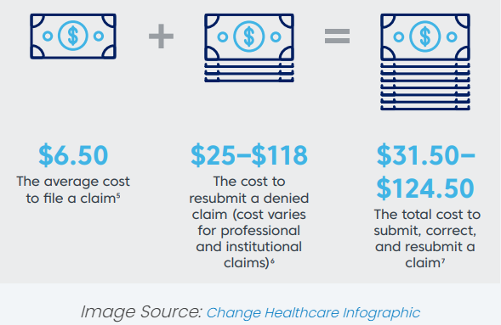
Cost reduction
Denial prevention
Denial prevention = revenue maximization
Costs more to appeal than to prevent
End to end process design decreases siloes
Siloes:
Increase denials
Extend AR
Increase cost per claim
Reduce margins

Slide 15
Denial Trends

Slide 16
Denial Trends
Through 2020, denials increased 23%, compared to 2016
Medical necessity denials doubled between 2017 and 2019 (27% to 53%)
Success rate for denial overturns (all payers) in 2021 was 45%
Down from 56% from previous years
In 2023 American Hospital Association (AHA) found Medicare Advantage denials increased 56% from Jan 2022 to July 2023
Commercial denials increased 20% in same period
In an Advisory Board survey, only 12% of hospitals reported alignment with payers in providing value-based services
June 2023 hospitals had a median of 124 days cash on hand, down 28% from Jan 2022
Misalignment between payers and providers not going away
Notes:
Has you system defined a denial? If you surveyed all your reve cycle leaders, would they say the same thing?
Is it 0 payment? Is it when the payor refuses to pay INPT and pays OUTPT instead?

Slide 17
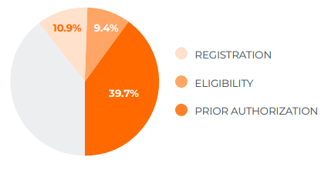
Denial Trends Continued
An HFMA survey found that 60% of denials are due to the front-end processes
40% due to prior authorizations
2018 report found that 65% of $262B in denials were never resubmitted/appealed

Slide 18
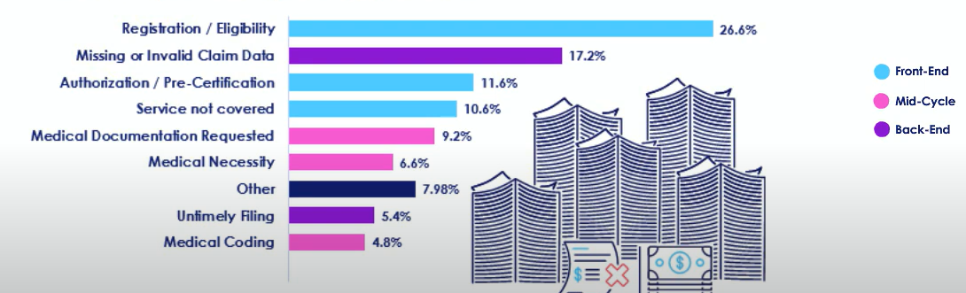
Denial Trends Continued
2020 Change Healthcare report found that 86% of denials are avoidable
Between 24% and 48% cannot be overturned/recovered
Eligibility and registration were biggest opportunities for denial prevention

Slide 19
Areas of Opportunity

Slide 20
Front End Process
Change perspective from managing denials to preventing them
Patient demographics
Insurance eligibility
Advisory Board identified unfavorable contract adjustments as top opportunity for leakage prevention
Aggressive growth leads to provider enrollment challenges
Is this part of the M&A planning process? Is it centralized?

Slide 21
Deeper Dive: Prior Authorizations
Physician Feedback
2022 American Medical Association survey found 90% of providers report prior auths becoming more burdensome
64% of MDs state step therapy mandates lead to inefficient care
46% MDs reported PA delays led to ER care
No alignment between payers
Opportunities for standardized processes
Who completes the PA?
Who completes benefits and eligibility check?
Up-front or POS collections?
Are CPT codes required for scheduling?

Slide 22
Case Study: Prior Authorizations
Academic medical center in Texas
$21M denied charges in one year r/t prior auths
Performed RCAs in the highest denial specialty areas
Plastics, Urology and Vascular
No single standard pre-auth process
There was no clear delineation of which pre-auths were done by surgeon office vs. central scheduling
Interdisciplinary team: scheduling, clinical, billing
Eliminated write-offs in their 3 target areas
Educated staff on pre-auth requirements
Developed CPT and payer cheat sheets
Required CPTs for scheduling

Slide 23
Insurance Verification
Without insurance verification, the rest of the process fails
NOA denials
Delayed UR process
Lower first pass clean claim rates
Denials
Collecting and recording insurance information is the tip of the iceberg
Has the client met the plan deductible
Referral requirements
Coverage percentage for planned procedures
Plan requirements for planned procedures
Is the treatment only covered under specific diagnosis code?
Do you have a quality assurance review for your automated process?

Slide 24
Case Study: Insurance verification
Banner University Medical Center centralized insurance verification for scheduled visits
Created central hub for patients to call and check on their pre-auth status, update their insurance, or ask about benefits
Integrated automated process with daily batch eligibility
Verifiers used portals or called payors as needed
Integrated financial responsibility calls to patients pre visit
Aligned access, verification, UR, and billing

Slide 25
Utilization Review
Black sheep of the revenue cycle
Tends to be bounced around between RCM and Nursing reporting lines
NOT a function – it’s a discipline
Specialized form of case management
UR best practices align with the revenue cycle:
Know the insurer
Coverage policies, submission requirements, deadlines, P2P process
Insurers use ‘guidelines’ (McG or IQ, typically)
UR should know when to bypass them
Best practice integrates communication between access, UR, PFS, case management, and physicians
Can be the canary in the coal mine
UR sees upticks in denials and OBS rates before the appeals/denials team does

Slide 26
Utilization Review: 2024 2MN rule (CMS-4201-F)
2 midnight benchmark applies to Medicare Advantage plans
Start of care is presentation, not admission order
MAs must make their coverage criteria publicly accessible (no pay walls)
Must be based on current evidence-based practice
Must be based on treatment of specific diseases or conditions
Must include the sources – peer reviewed journal articles, etc.
Must demonstrate that the clinical benefits of the criteria outweigh the risks
Hospital-level services:
CMS does NOT address intensity, only that the services provided were hospital-level (as opposed to SNF, infusion center)
Interpretation: McG or IQ screening guidelines for OBS or INPT = hospital level care
MA plans must establish a UM Committee
Ask for standing meetings with MA UMC
Involve your physician advisor

Slide 27
UR, Appeals, and the 2MN Rule
2MN ruling integration
How aggressive is your system in fighting for 2MN stays?
Is your UR process aligned with your appeals process?
Are you tracking key metrics?
MA plan OBS rates
2+MN MA plan OBS stays
2+MN inpatient denial rates and overturn rates
Report violations to your CMS regional office
Address with contracting
Don’t include language in MA contracts that contradict the rule
CMS trumps contracts

Slide 28
Alignment: Utilization Review and Appeals
Do you have an appeals strategy?
Appealing only based on medical necessity
Possibly too conservative
Could lead to cherry-picking cases
Appealing everything:
May lead to increased administration overturn by the payer
Can be resource intensive
Utilize AI or software solutions
Something in between
Payers with high reimbursement rates and low overturn rates may need different strategy
 | Unavoidable | Avoidable
Non-Recoverable | ANALYZE Current workflow and processes | PREVENT Future denials
Recoverable | MANAGE Appeal processes | PREVENT Future denials and manage appeals

Slide 29
UR and Appeals Continued
Payers with high overturn rates
High overturn rates = unnecessary administrative burden
Why are they high? How can the denials be prevented?
Involve contracting if needed
Low overturn rates
Design better UR process
Payer specific templates
Sending raw medical records vs clinical narrative
Payer specific?
More opportunities for P2Ps
Opportunities not related to medical necessity – go back to applicable department
Payor behavior vs avoidable denials

Slide 30
UR and Appeals Continued
Denials RCA
Where are your denials coming from?
Have you validated your classifications
Spot checks? Audits?
Denial analytics software
Root causes – quality assurance?
Focus PI opportunities
Alternative staffing resources
Utilize AI
Utilize appeals on behalf of the patient
Nonclinical denial team
Only utilize RNs when an appeal letter needs to be written
Align UR and Appeals
Close the loop: provide feedback to practices/providers

Slide 31
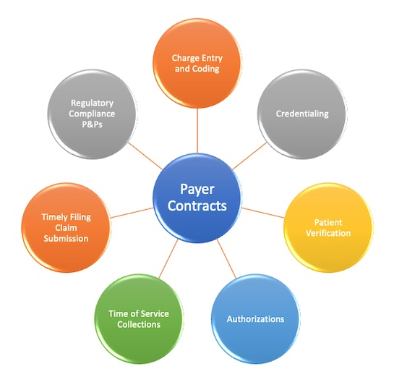
Alignment: UR, Appeals, Contracting
Revisit unfavorable contract terms
Levels of appeals
CPT correction/update when intraoperative changes occur
Retroactive authorizations
NOA timelines
Physician advisor allowances
Are third party advisors allowed?
Peer to peer timeframes
Frequency of clinical reviews
Admin day allowance
Coverage of extended stays for SDoH or transitional care issues
Are DRG payers acting like percent of charges payers?
Partial denials
Continued stay reviews

Slide 32
Aligning UR, Appeals, and CDI
Primary opportunity for physician education
Streamline messaging
Bundle education to reduce burnout
Improved documentation helps all departments
Partner on best practice alerts
Reduce BPA fatigue
Include physician advisors
Physician champions are key to MD behavior change
Develop shared clinical and RCM metrics

Slide 33
Case Study: Denials Dashboard
Moffitt Cancer Center
Reduced denials from 14% to 8% of gross charges
Developed interdisciplinary team
Designated project manager to track data trends and conduct RCAs
Sampled payer denial codes to determine accuracy
Developed subcommittees to further deep dive
Determined KPIs
Developed denials dashboard
Overview of top denial opportunities
RCA review
Department reviews:
Case management
HIM
Appeals/UR
Billing
Coding

Slide 34
Other Mid-Stream Opportunities
CDI and Coding
Prevent under-coding
Collaborate to determine documentation improvement opportunities
Revenue Integrity
Leverage process engineers
Value stream mapping
Project management
Audits
KPI development
Lynchpin to reduce siloes

Slide 35
Creating Better Alignment

Slide 36
Value stream mapping
Lean manufacturing concept
Create a visual guide of all necessary components of a product or service
Map current state
Design future state
Implement changes
Improve efficiency and standardization

Slide 37
Where are your alignment opportunities?

Slide 39
References
“National Hospital Flash Report: November 2023,” Erik Swanson, KaufmanHall, November 28, 2023 (https://www.kaufmanhall.com/insights/research-report/national-hospital-flash-report-november-2023)
“5 factors shaping healthcare in 2024: Report,” Naomi Diaz, Becker’s Health IT, December 6, 2023 (https://www.beckershospitalreview.com/healthcare-information-technology/5-factors-shaping-healthcare-in-2024-report.html?origin=CIOE&utm_source=CIOE&utm_medium=email&utm_content=newsletter&oly_enc_id=5878G0123745E2Z)
“Medicare Advantage Denials Jump 56%, Commercial Denials 20%,” Jacqueline LaPointe, RevCycle Intelligence, November 21, 2023 (https://revcycleintelligence.com/news/medicare-advantage-denials-jump-56-commercial-denials-20)
“2022 AMA prior authorization (PA) physician survey,” American Medical Association, retrieved from website November 9, 2023 (https://www.ama-assn.org/system/files/prior-authorization-survey.pdf)
“2022 Update: Measuring progress in improving prior authorization,” American Medical Association, website page accessed October 25, 2023 [https://www.ama-assn.org/system/files/prior-authorization-reform-progress-update.pdf]
“Health systems plagued by payer-takeback schemes, 110,000 denials,” Andis Robeznieks, AMA, January 19, 2023 (https://www.ama-assn.org/practice-management/prior-authorization/health-systems-plagued-payer-takeback-schemes-110000)
“Providers See Fourfold Increase in External Payer Audits,” Jacqueline LaPointe, RevCycle Intelligence, December 8, 2023 (https://revcycleintelligence.com/news/providers-see-fourfold-increase-in-external-payer-audits)
Marble, K. Y., Briggs, G. R., & Gordy, X. Z. (2022). Improvements for the Prior Authorization Process for Elective Surgical Procedures at an Academic Medical Center. Perspectives in health information management, 19(1), 1l.
Corder J. C. (2018). Streamlining the Insurance Prior Authorization Debacle. Missouri medicine, 115(4), 312–314.
“the Executive’s Guide to Implementing a Denials Program.” Vyne Medical, 2018. Executive-Guide-to-Implementing-a-Denials-Program.pdf (vynemedical.com)
“11 Things CEOs Need to Know in 2024.” Advisory Board, 2024. https://www.advisory.com/content/dam/advisory/en/secure/content-resources/2024/11-things-ceos-should-know-in-2024.pdf.coredownload.pdf

