Slide 1
Breaking the Cycle Denial Trends: Downgrades & Ghost Denials

Slide 2

Meet the Presenter
Jeff Podraza, JD
President & GM - Denials

Slide 3
Discussion Overview
1
2
3
4
Today’s Landscape: Complex Denials
Best Practices: Denials Team Structure and Processes
Tracking and Measuring Complex Denials
Managed Care / Contracting / Compliance

Slide 4
Discussion Overview
1
2
3
4
Today’s Landscape: Complex Denials
Best Practices: Denials Team Structure and Processes
Tracking and Measuring Complex Denials
Managed Care / Contracting / Compliance

Slide 5

Today’s Landscape: Clinical Denials
Clinical Denials Have Increased – Particularly Complex Denials
15-20%
AVERAGE INCREASE
IN CLINICAL DENIALS
Over the last 5 years, Aspirion has seen a 15%-20% average increase in clinical denials including:
Authorization
Medical Necessity

Slide 6
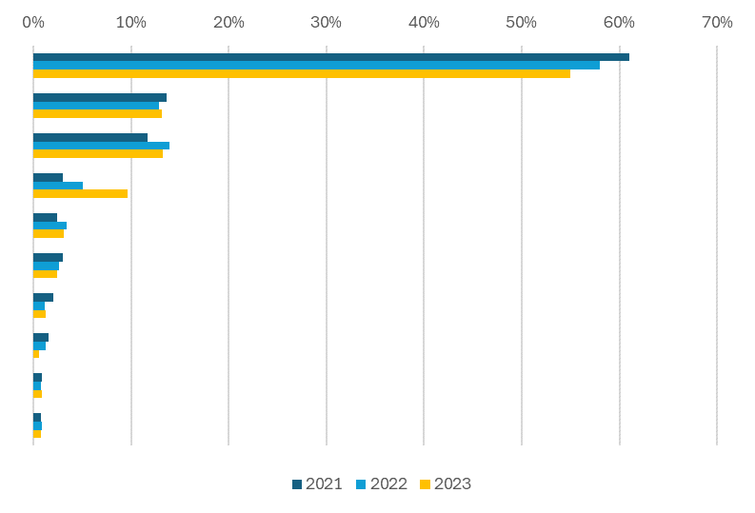
Today’s Landscape: Clinical Denials
Authorization Denials – by Top 10 Auth Denial Type/Issue – 3 Year Trend
10% Decline in Blanket “No Authorization” Denials
300% Increase in “Level of Care/IP Not Authorized” Denials

Slide 7
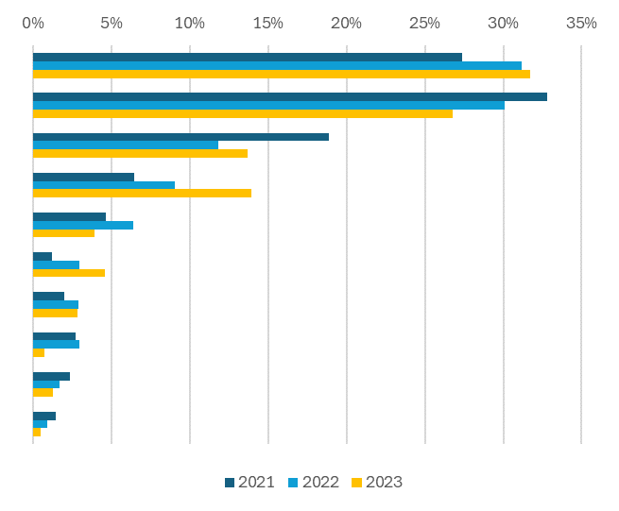
Today’s Clinical Landscape
Medical Necessity Denials – by Top 10 Med Necessity Denial Type/Issue – 3 Year Trend
19% Increase in “Level of Care/IP Downgrade” Denials

Slide 8
Today’s Landscape: Clinical Denials
Clinical Denials Have Increased – Particularly Complex Denials
DRG Downgrades
Bundling / Charge Audits
Level of Care Downgrade Payments
Inpatient to Outpatient
Inpatient care levels
ED Acuity Levels
Non-Covered Services
Complex Denials

Slide 9

Ghost Denials Defined
What does that mean?
Not well-defined by the payer
Unable to quickly identify
Providers across the country are no longer simply accepting these denials and are now taking more proactive approaches to limit and mitigate effects.
Ghost Denials
Denials that are not well-defined by the payer or are unable to be accurately and quickly identified by the provider without in-depth analysis.
So, what can you do?

Slide 10
Breaking the Cycle: How to Overturn These Denials
Identify the denial
Review claim, EOB, denial letter
Call payer for clarifying details
Research denial validity
Do you agree or disagree with the denial?
Assess arguments for denial overturn
Strength of argument to overturn, and likelihood of success
Craft a compelling dispute/appeal
Utilize supporting documentation, include contractual arguments and legal arguments where appropriate.

Slide 11
Discussion Overview
1
2
3
4
Today’s Landscape: Complex Denials
Best Practices: Denials Team Structure and Operational Processes
Tracking and Measuring Complex Denials
Managed Care / Contracting / Compliance

Slide 12

Best Practices: Team Members
Which team members operate as part of your denials team?
PFS reps, nurses, coders, billers, physician advisors – anyone else?
Many provider systems understand the importance of having a physician advisor on the denials review team, and more systems are adopting this practice, in addition to nurses and coders.
When the clinicians work together with coders and other team members, they can dig into the actual nuts and bolts of the claim and understand what’s happening with that account.

Slide 13
Best Practices: Team Operational Processes
Do they only work certain denials? (clinical vs. technical)
Is the team responsible for audits – pre-pay, post-pay, clinical validation, DRG, disallowed charges?
Do they work only certain payers or payer types? (Commercial/Medicare/Medicaid/Other Govt)

Slide 14

Breakout: Sepsis DRG Downgrade Query Checklist
15 Queries Designed to Surface Key Factors That Support Sepsis Care
"Was there a confirmed infection, and what was the source of the infection?"
"Was the patient's temperature greater than 38°C or less than 36°C at any point during the hospital stay?"
"Did the patient's heart rate exceed 90 beats per minute during the hospital stay?"
"Was the patient's respiratory rate greater than 20 breaths per minute or was the arterial carbon dioxide tension (PaCO2) less than 32 mm Hg?"
"Did the white blood cell count exceed 12,000/µL, was it less than 4,000/µL, or were there more than 10% immature (band) forms?"
"Was there evidence of hypotension, specifically systolic blood pressure less than 90 mm Hg or a reduction of greater than 40 mm Hg from baseline?"
"Did the patient exhibit renal dysfunction, such as an abrupt increase in serum creatinine or reduced urine output despite adequate fluid resuscitation?"
"Was there respiratory dysfunction, indicated by a PaO2/FiO2 ratio less than 300 or the need for mechanical ventilation?"
"Did the patient have liver dysfunction, with an increase in bilirubin to levels more than 2 mg/dl?"
"Were there coagulation abnormalities, such as a platelet count less than 100,000 µl or significant drop from baseline, or presence of disseminated intravascular coagulation?"
"Was there any neurological dysfunction, such as altered mental status without an alternative explanation?"
"Were lactate levels elevated, indicating tissue hypoperfusion?"
"What treatments were administered specifically for the management of sepsis and the associated organ dysfunctions?"
"Was there documentation of the patient's baseline organ function prior to the onset of sepsis for comparison?"
"Were any other causes of hypotension, besides sepsis, identified and ruled out during the patient's hospital stay?"

Slide 15
Best Practices: Escalation Efforts
Does your team collaborate with payers to resolve trending denials - Joint Operating Committees (JOC) meetings, payer provider relationships?
Does your team collaborate externally with other hospital systems directly, or indirectly through networking groups?
How far does your team take a denial – peer to peers, internal appeals, external appeals, arbitration/litigation prep?

Slide 16
Discussion Overview
1
2
3
4
Today’s Landscape: Complex Denials
Best Practices: Denials Team Structure and Processes
Tracking and Measuring Complex Denials
Managed Care / Contracting / Compliance

Slide 17
Tracking and Measuring
How are you tracking these complex denials today: within your patient accounting system, or separately?
Do you have internal thresholds for denial amounts in these categories that your health system does not pursue?
Have you established internal benchmarks regarding denial overturn rates for these claims?

Slide 18

Tracking and Measuring
What steps can you take to prevent these denials on a forward-going basis?

Slide 19
Discussion Overview
1
2
3
4
Today’s Landscape: Complex Denials
Best Practices: Denials Team Structure and Processes
Tracking and Measuring Complex Denials
Managed Care / Contracting / Compliance

Slide 20
Managed Care / Contracting / Compliance
How robust is the feedback loop with your managed care / contracting / compliance team with regards to these denials?

Slide 21
Managed Care / Contracting / Compliance
What type of contract language do you currently have pertaining to audits?

Slide 22
Managed Care / Contracting / Compliance
Contract Language Wish List
Right to appeal, how many levels, response time
Right to third-party review, IRO, and/or arbitration
Right to be paid in full BEFORE any audit commences
AR threshold limitations (by % of volume or dollars) for payer’s right to audit
Timeframe for audits: from date of discharge, date of first payment or processing date
No refunds or recoups before expiration of appeal timelines
Require written notice of detailed audit reasoning
Acknowledgement that an itemized bill is insufficient to perform charge audits
Audits by health plan exclusively, no third-party company or vendors the health system isn’t contracted with
Single audit allowed per claim (of any kind)
Defining which coding guidelines will be used (CMS, InterQual, Milliman, etc.)

Slide 23
Thank you
Jeff Podraza, JD
President & General Manager, Denials Direct: 571.218-7861 • jeff.podraza@aspirion.com

