Slide 1
Community Groups
June 2024
Notes:
1:15 – 2:00pm
Cindy

Slide 2
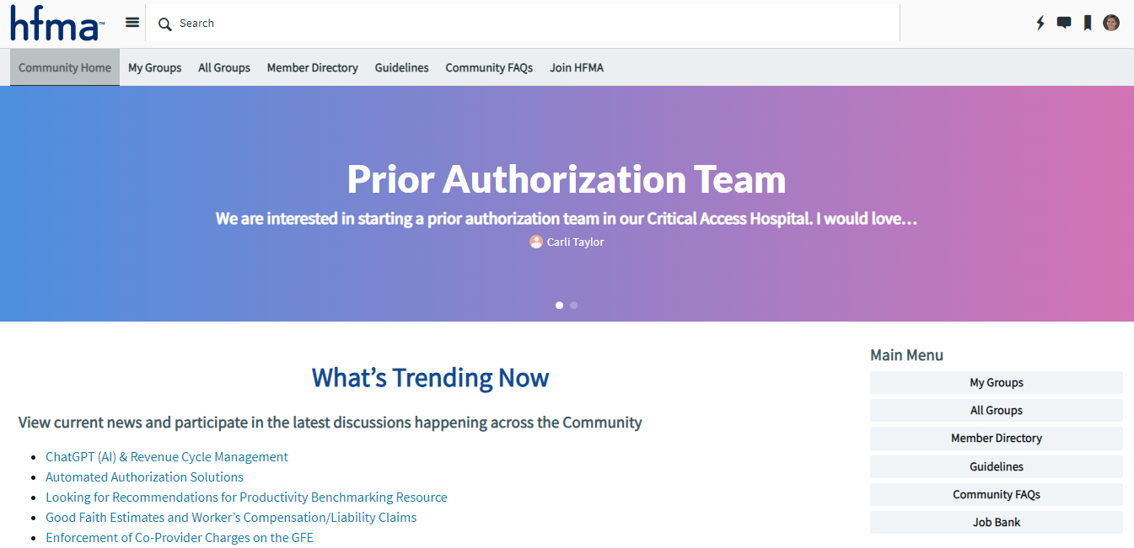

Community Home Page
Notes:
Access the Community Home Page from the hfma home page -> Discover -> Access Online Community
Once on the community home page, confirm you are logged in (upper right hand corner – same log in as hfma.org)
The groups you are part of can be viewed under My Groups (either top ribbon or side list) – NOTE this is also where you will find the Member Directory and Job Bank

Slide 3
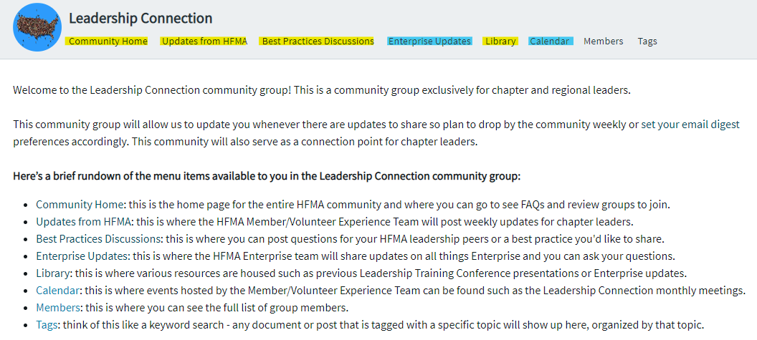
Leadership Connection Community
Notes:
All chapter leaders are included as members of this community
Default communication is to send a weekly digest of community activity
Use Best Practice Discussions area to post questions to other chapter leaders

Slide 4
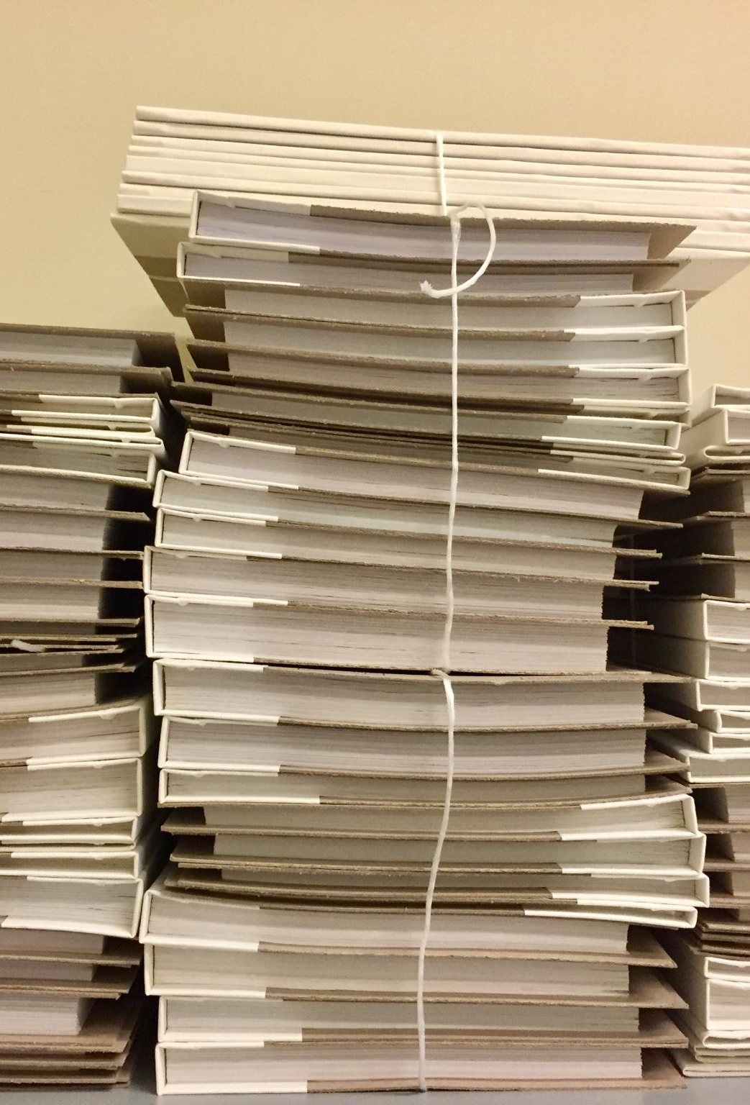
Chapter Community
Access provided to Officers and Directors
Member survey results are posted here
Library available to store important documents (i.e. Board minutes, chapter financials)
Notes:
Every chapter has a community for their leaders (as well as regions for the RE Team and P/PEs)

Slide 5

What questions do you have?

