Slide 1
Chapter Resource Center
June 2024
Notes:
1:15 – 2:00pm
Cindy

Slide 2

Chapter Resource Center
Access provided to those listed in a leadership position for the current year
  President can update roster with any changes throughout year
  Access for next year provided 60 days prior to effective date (i.e. April 1st)
Log in to hfma.org, then go to Chapter Resource Center at bottom of home page
Notes:
Updates ensure communication goes to correct person in chapter
Email Volunteer Exp Team to remove someone from roster

Slide 3
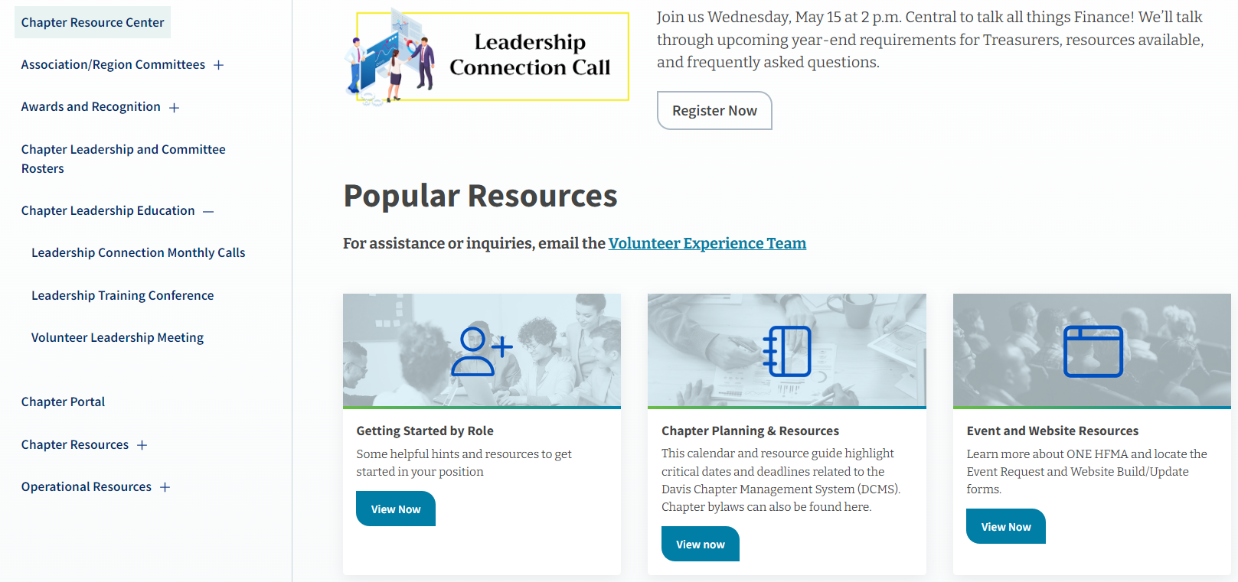
Landing Page
Notes:
Walk about the landing page:
Popular Resources (self explanatory – will go through each of these)
Sections on left hand side (Chapter Resources, Chapter Leader Education, etc)
LOTS of info, especially in Chapter Resources and Operational Resources
Moving stuff around in these two sections to be more user-friendly
Click on + to expand to see sub-headings (Chapter Leader Education as an example)
Chapter Portal – Access limited further to Officers and committee chairs for Certification, Communication (incl Social Media), Awards, Membership, (incl Enterprise & Directory) Programs, Sponsorship
Chapter Leadership and Committee Rosters – Go here to make any additions to your roster during the year (email our team to remove anyone)
Three others not pictured: Leadership Connection Monthly Calls, Online Community Resources, “Where is it now” Guide
Ethics Training & Materials at bottom of page

Slide 4
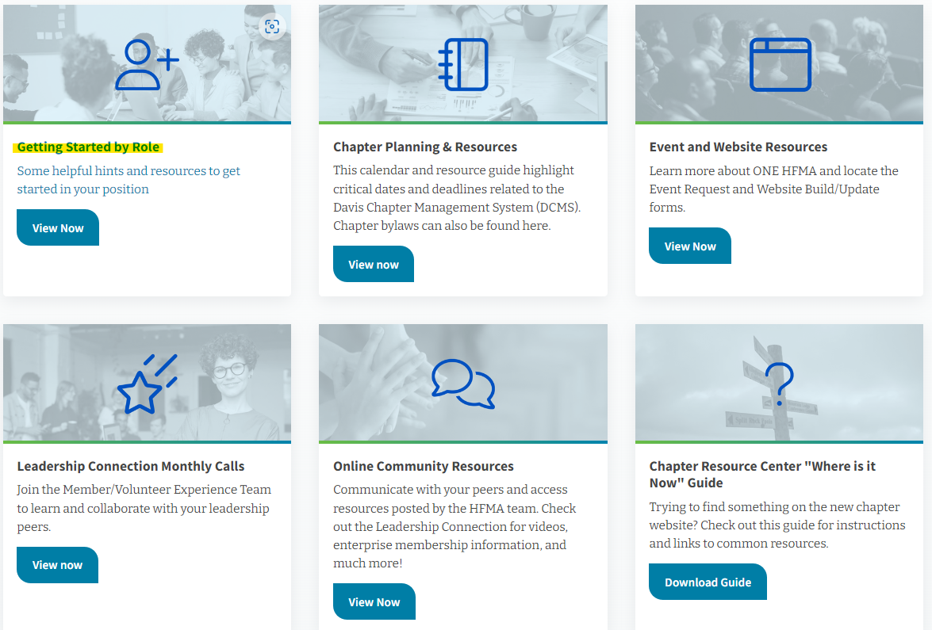
Notes:
Helpful information for key roles within the chapter – Officers PLUS Events/Programs, Membership, Communication, and Founders

Slide 5
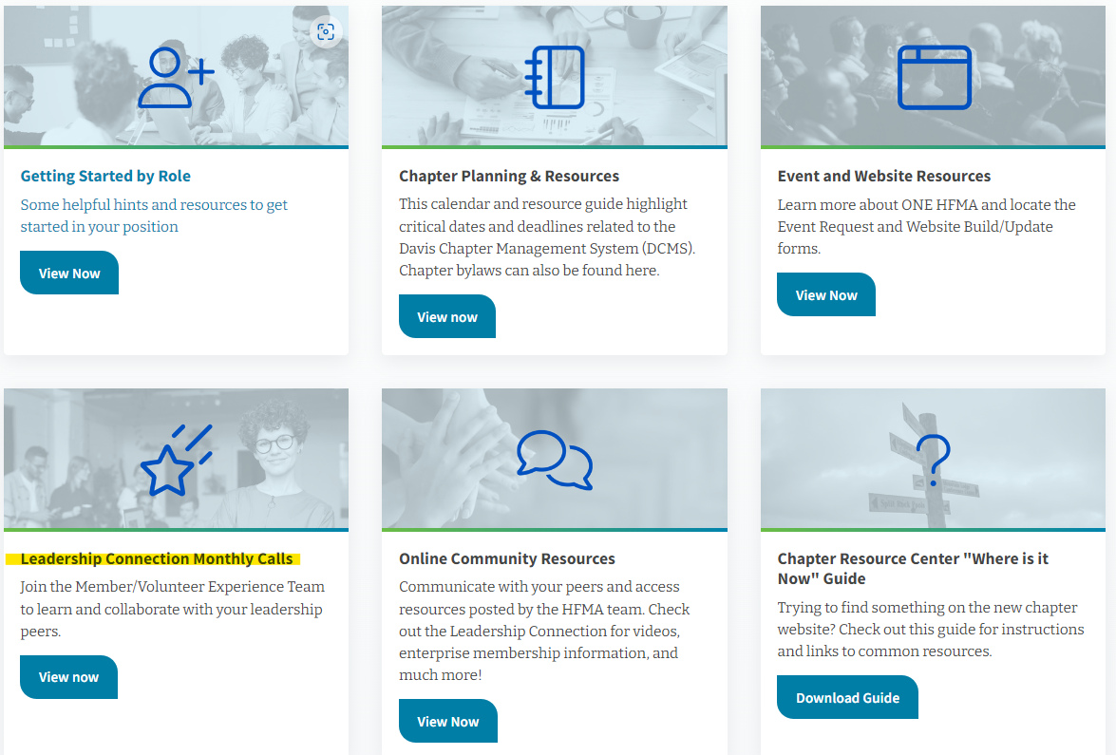
Notes:
Recommend President and/or President-Elect attend, but any chapter leader is welcome!
Enterprise Team does an update at the beginning of each meeting (new organizations, orientations, and renewals)
Topics to be covered are usually posted in the community the week before as well as on social media

Slide 6
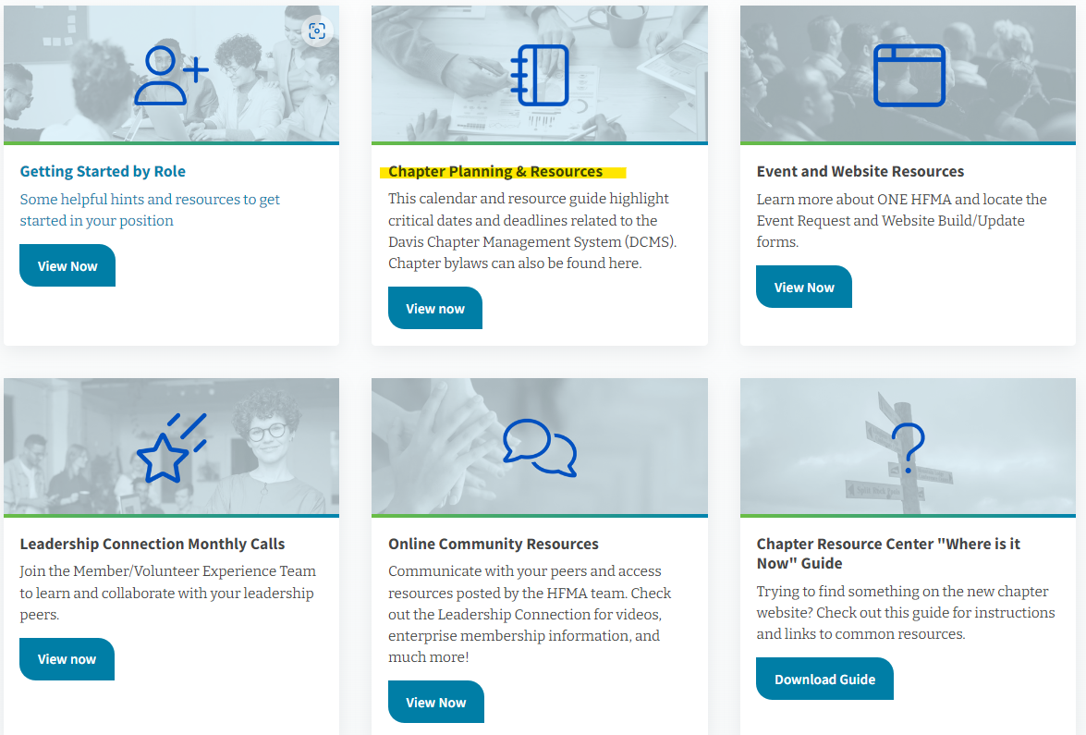
Notes:
Dates to remember – Key dates for leaders to remember – also includes links to helpful resources on Chapter Resource Center
DCMS policy – Includes all requirements/due date for chapters – Need to meet ALL requirements in order to be eligible for the Success Awards
Chapter Bylaws – All info about bylaws in this area – model as well as each chapter’s bylaws

Slide 7
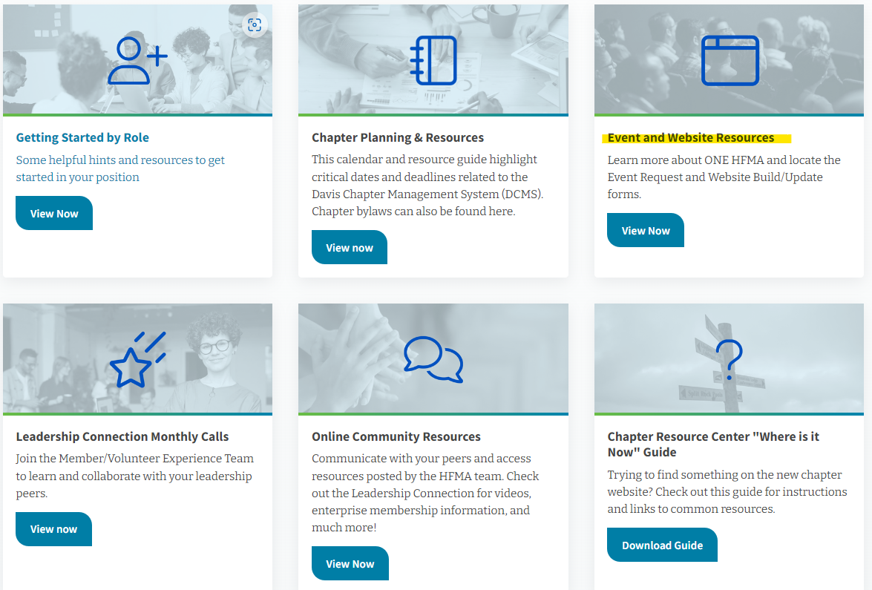

Slide 8
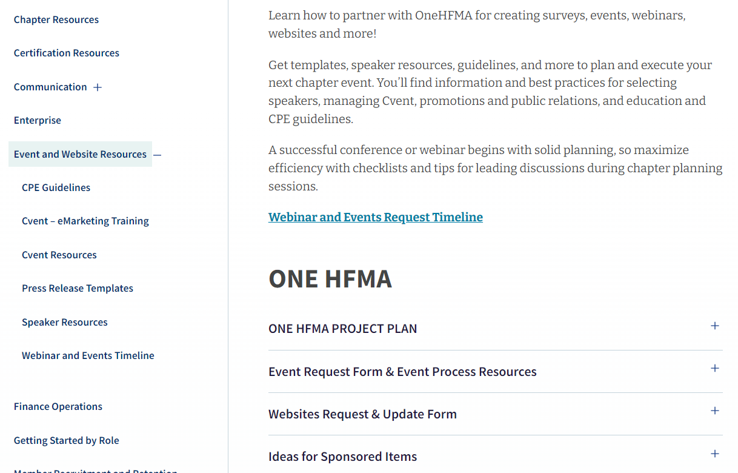
Notes:
EVERYTHING events/program related
ONE HFMA Project Plan and other resources
Event request form
Event Planning section – LOTS of info!
Website update form – submit for any updates to website (i.e. President’s Message, Leadership page, Sponsorship)

Slide 9

What questions do you have?

