Slide 1
Medicare as existential threat… really?

Slide 2
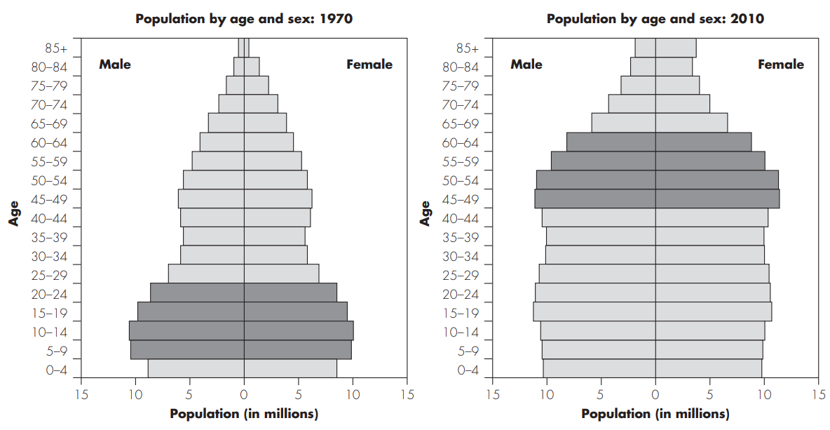
Medicare is growing fast!

Slide 3
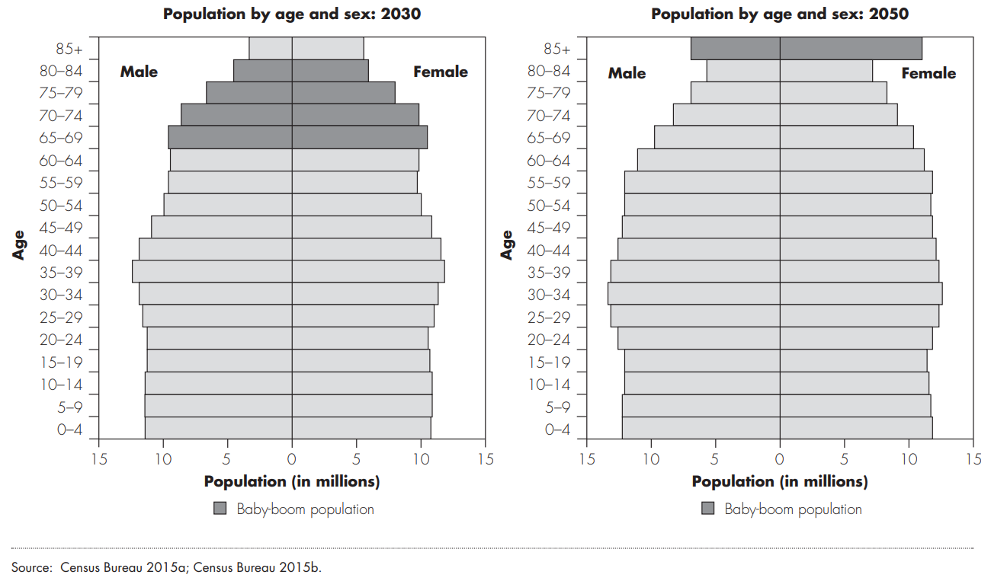
Medicare is growing fast!

Slide 4
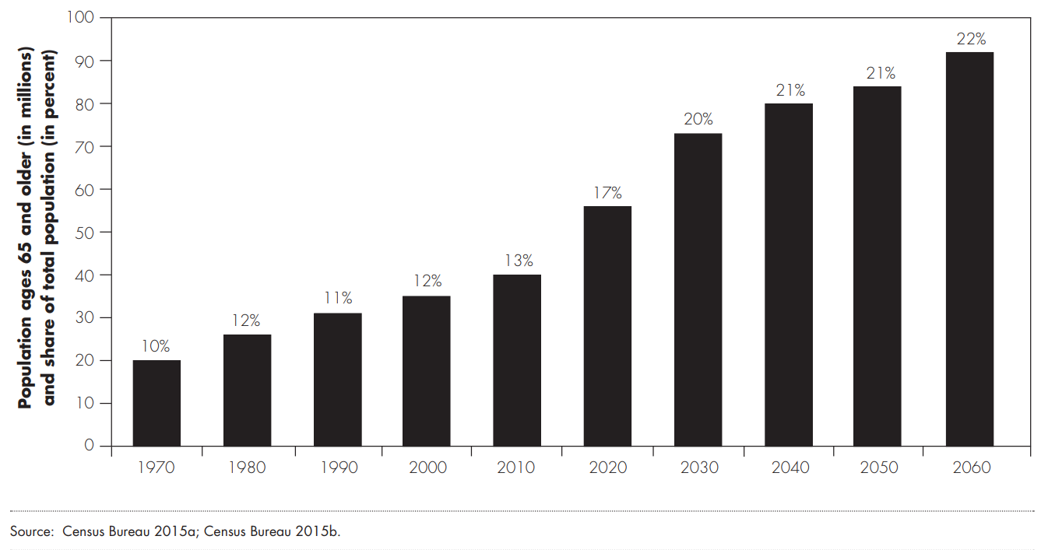
Mcr pop. growth will slow, but will remain high!

Slide 5
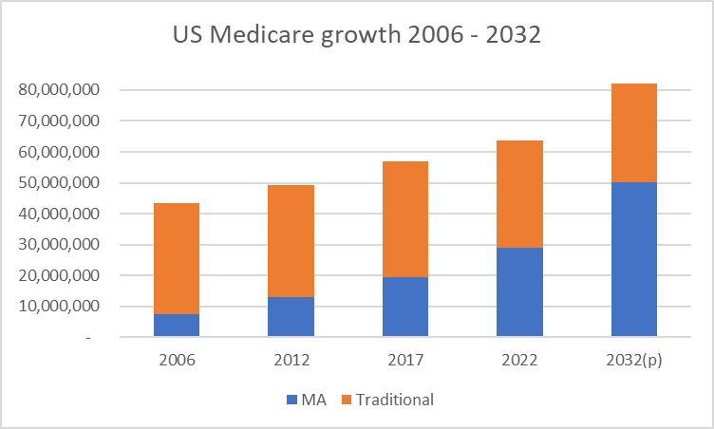
Medicare advantage is growing fast!

Slide 6
Medicare advantage is growing fast!

Slide 7
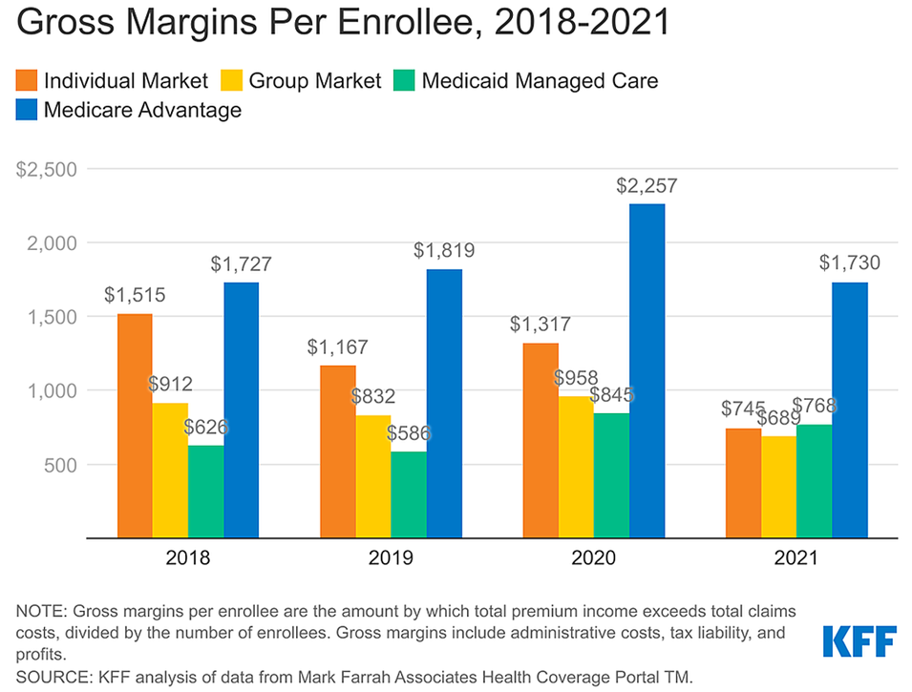
Medicare advantage plans are very profitable for MCOs

Slide 8
But Medicare advantage isn’t great for hospitals
2022 MA revenue would have been $49 mil more if paid same yield as Medicare

Slide 9
Medicare growth is changing everything
Our industry developed here

Slide 10
Medicare growth is changing everything
But now we are here

Slide 11
Projecting out to 2032
Assume the following:
Overall Services, Costs and Total Charges grow at same rates as '12 - ‘22
Medicaid and self-pay stay at same portion of total
Trad MCR and MA both grow at same rate as '12 - ‘22
Commercial svcs and charges 'fill in' the remainder
Yields on Medicare, Medicaid and Self-pay stay at '22 levels; Comm'l grows at same rate as '12 - ‘22
MA is 70% of total Medicare by 2032 (vs. 53% in 2022)

Slide 12
Projecting out to 2032

Slide 13
Projecting out to 2032
2032 MA revenue will be $131 mil less than if paid same yield as Medicare

Slide 14
2032 if MA pays the same as MCR
2032 MA is better, but we still have a significant problem from MCR growth

Slide 15
Possible actions
New Revenue opportunities
Specialty Pharmacy, 340(b) expansion, others?
Bring MA plans to 100% of Medicare yield
$131 mil gap by 2032
Boost Commercial MCO reimbursements by $160 mil
3%/yr assumed – 4.2%/yr needed
Control Costs
3.3% annual increase assumed
Keeping to 2.9%/ yr saves $90 mil by 2032

