Slide 1

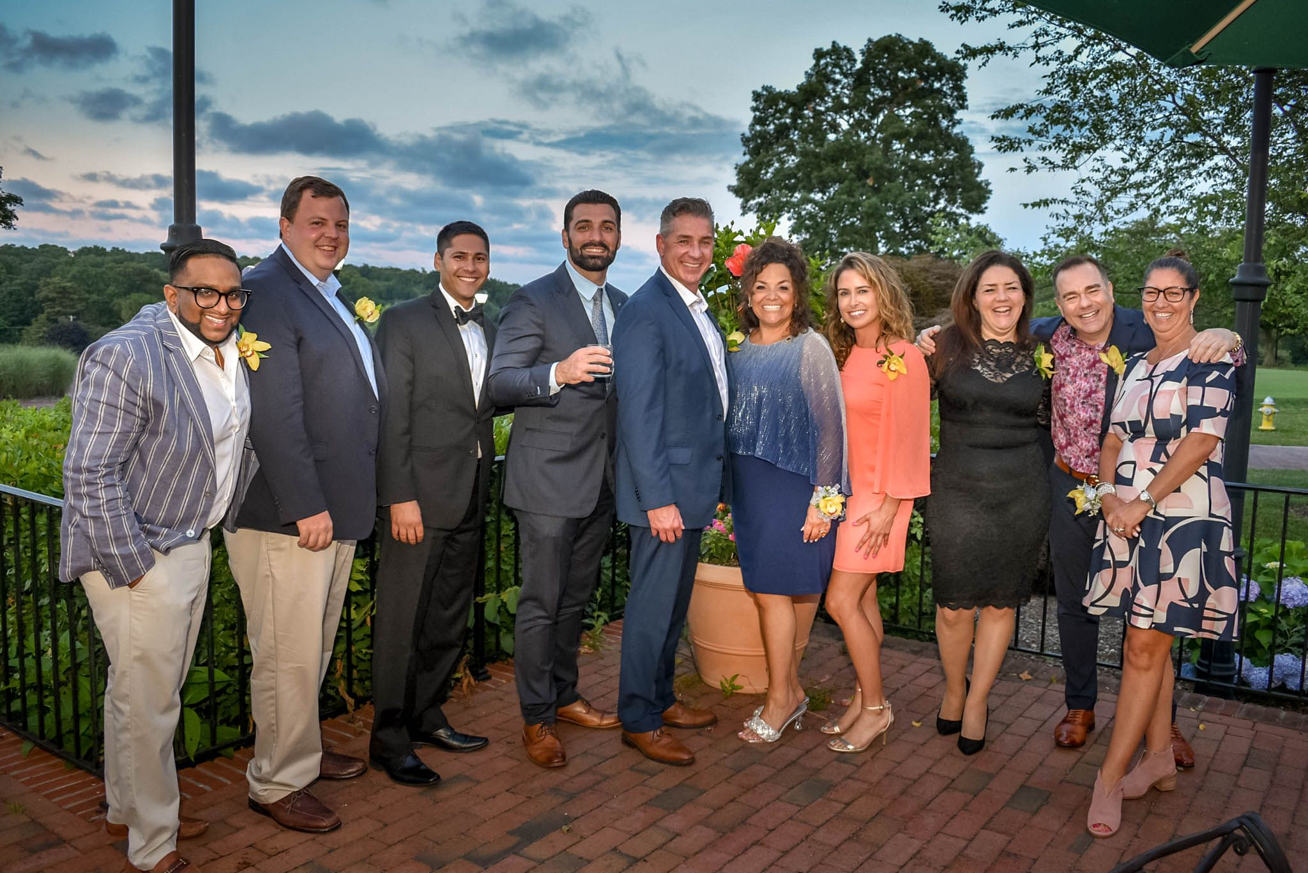
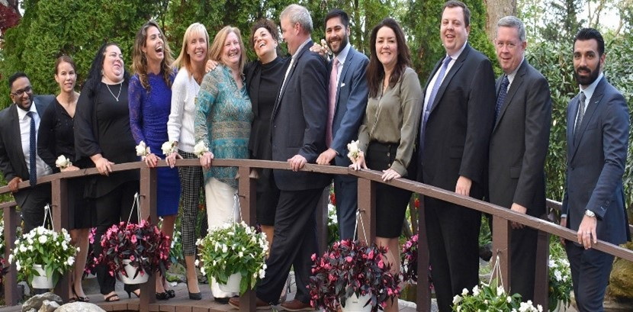
L
Notes:
Jennifer

Slide 2
Benefits – Available to all US-based members
Certifications
All of HFMA’s recognized industry credentials are included in your membership.
Unlimited Healthcare Financial Specific Education
In-Person conferences
Webinars
Podcasts
Chapter Membership
Interactive online forums and community groups
Significant member-only savings on chapter programs and events
Notes:
We know this is a great deal of information in a short amount of time. Slides will be shared with everyone to reference later. I will be monitoring questions placed in the chat. In the interest of time, we will answer all questions within the chat if they are not specifically addressed in the presentation. You can also reach out to us via email any time you have questions. The final slide has our contact information.
Honorable Mentions: Catherine Ekbom is our current president and Andrew Weingartner is our President Elect who will be our president in the coming year.

Slide 3

Education/Networking Opportunities
Chapter Events | Average CPE's
Monthly Webinars | 1-2 hours each
Annual Institute | 12-16 hours
Annual Golf Classic
Leadership Dinner
Knowledge is Power Series Events
Revenue Cycle Academy | 7-8 hours
Reimbursement and Account Updates | 7-8 hours each
Association Events
Revenue Cycle Conference
Annual Conference
Leadership Training Conference
Educational Workshops
On-Demand Learning
HFMA can cover all required educational requirements

Slide 4
Why Get Certified
Because earning a certification validates your proficiency.
And, the benefits of getting certified range from higher salary, increased job fulfillment to improved organizational performance.
Reach your professional goals by enhancing your industry knowledge.

Slide 5
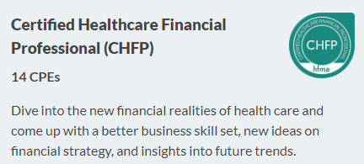
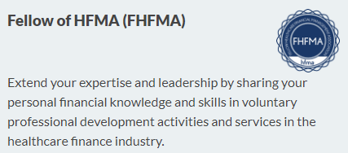
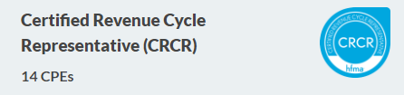

Certification Opportunities
Notes:
Certifications require CPE’s to maintain and renew
No annual testing requirements

Slide 6
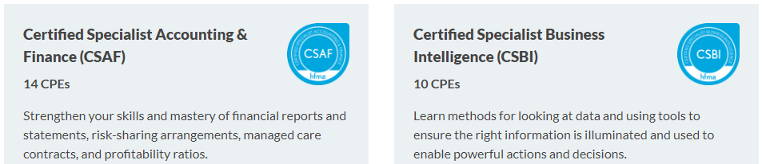
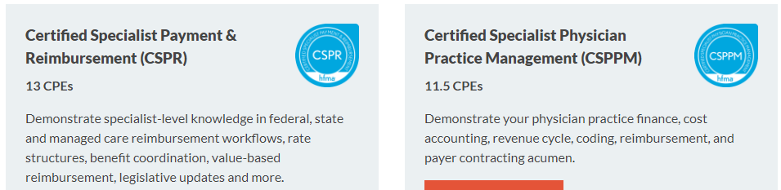
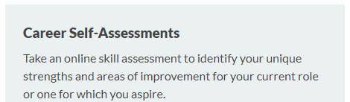


Slide 7

Community
Connect & Communicate
Build on conference sessions with a follow-up Q&A session with speakers
Share valuable resources and success stories of overcoming challenges
Mentor & Lead
Mentor a new member. Help them belong to and be involved with HFMA
Member Tools
Advanced email notification settings such as curated daily and weekly digests
Stay connected beyond events/conferences and continue the discussion in a secure online space
Communicate with other industry experts, facilitate meaningful conversations and discuss best practices
Share & Collaborate
Share your expertise and gain visibility through self-publishing articles and discussions
Get answers to questions, or new ideas from industry experts to solve problems
Lead conversations on important topics
Share advice on career paths and certifications
Looking for a Mentor? Reach out to be paired with a mentor today!
Responsive mobile design for members to stay updated and participate on the go
Connect fellow members to conversations with @mentions feature similar to Facebook and LinkedIn
Notes:
The Lone Star Chapter’s Mentoring program has mentors from all areas of Healthcare ready and willing to provide mentoring services to those interested in obtaining knowledge and guidance from experienced healthcare personnel.
If you are interested in participating in the Lone Star Chapter Mentor program, as a mentor or mentee, please contact Vicki Galati, VP of Revenue Integrity at Texas Health Resources.
***Chris will introduce Shane Baker from HFMA to cover the logging in, updating and adding community groups.
***Shane will also show how leaders can assign learning modules to their staff. (15 minutes)

Slide 8
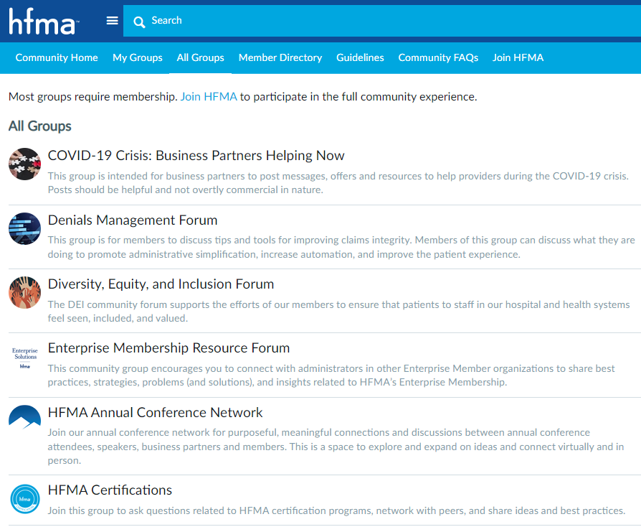
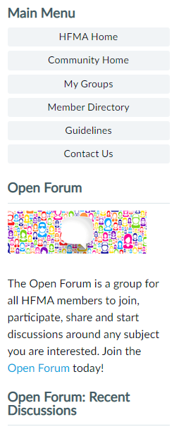
Community and Forums
Visit HFMA.org to:
Personalize your Content
Access The Member directory
Access the Job Bank

Slide 9


Managing Community Group Notifications & Emails
Want fewer emails from the Community group and still stay informed?
Take simple steps to customize your notification settings to receive alerts in a cadence...
HFMA Community - Managing Emails and Notifications
Learn how to update your notification settings so you receive notifications in a cadence that works best for you.
Managing Community Email Notifications and Accessing Your Member Satisfaction Surveys Online
We've put together a helpful resource to walk you through how you can Managing Community Email Notifications
Did you know that you are able to manage the frequency of your notifications?

Slide 10
Contact the HFMA Metro New York Chapter via email to learn more MetroNY@HFMA.org

